Slide 1
The single-cell transcriptome landscape in human tissues
7/31/2019
Notes:
大家好，今天我总结一下目前的一些进展。

Slide 2
Content
Part1: Overview of GeACT
Part2: Cell type identification and annotation
Part3: Transcriptional regulation across cell-types
Part4: Co-expression modules within each cell type
Part5: The spatial - specific expression
Notes:
Figure tissues:
Figure 96-well plate:
Figure NGS: https://coursesandconferences.wellcomegenomecampus.org/our-events/next-generation-sequencing-2019/

Slide 3



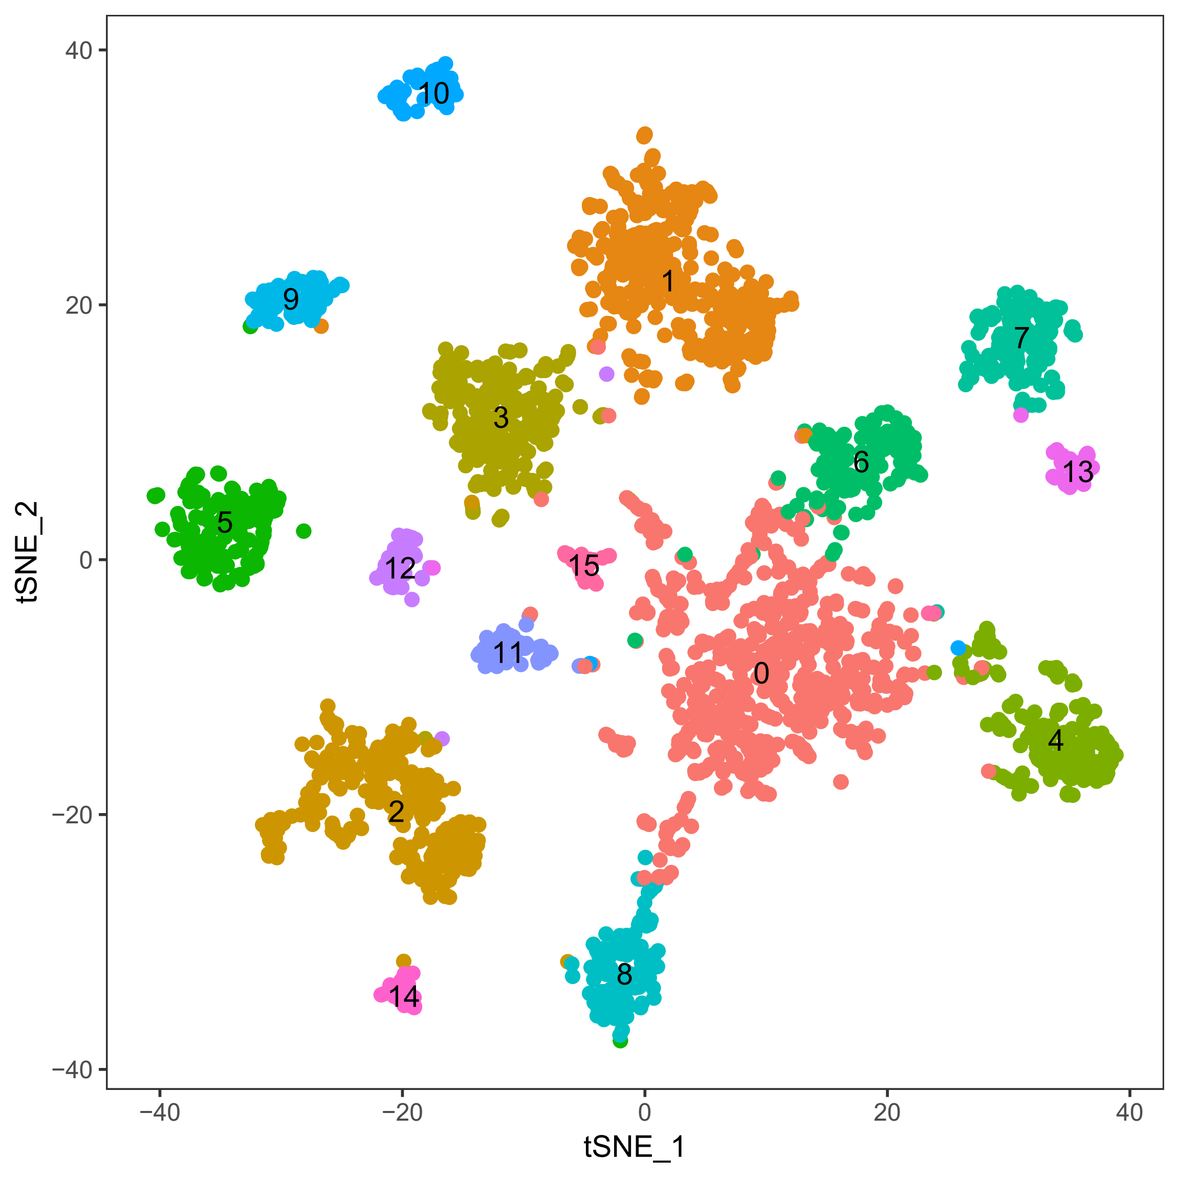



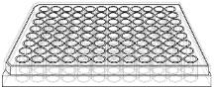
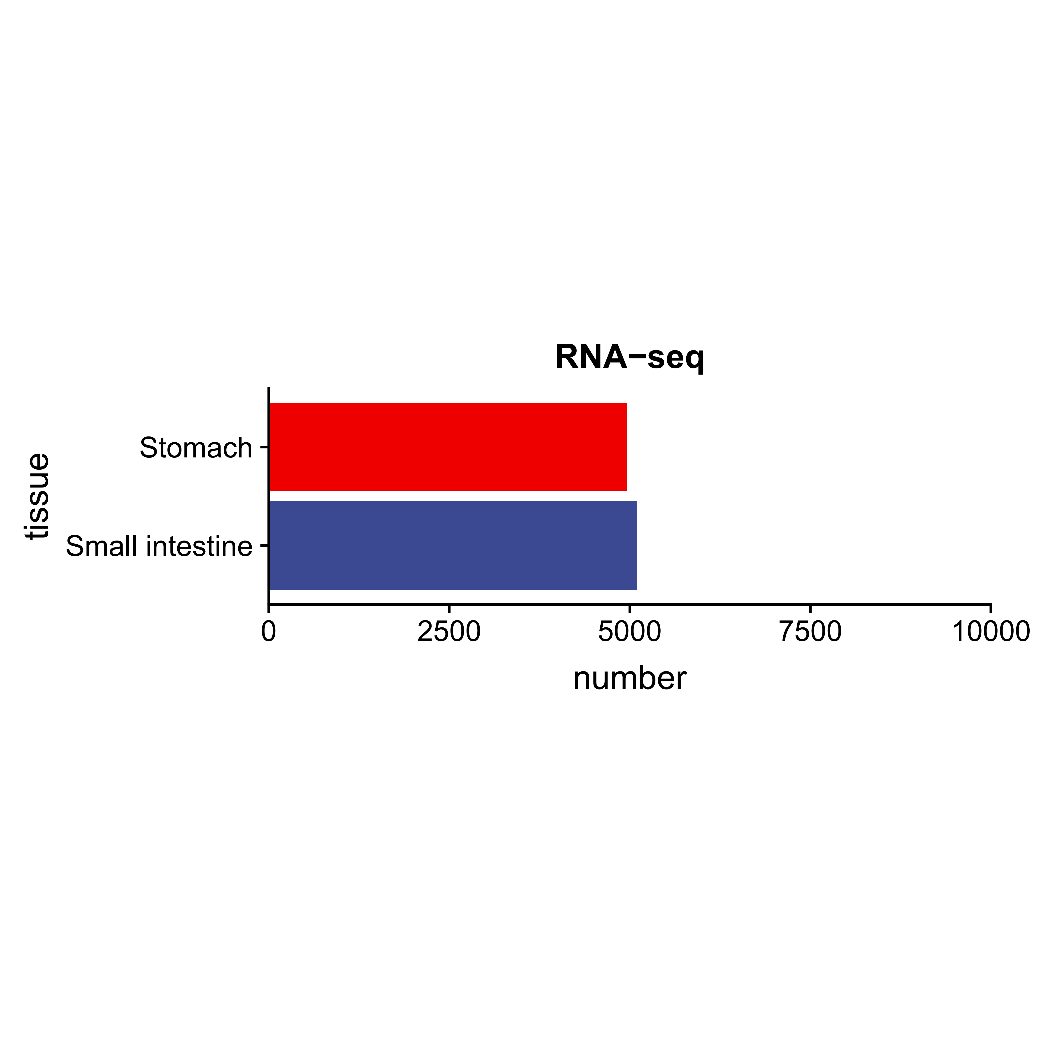
Part1: Overview of GeACT
A
Sampling
FACS sorting
Sequencing
Data analysis
B
C
ATAC-seq
Notes:
Figure tissues:
Ovary: https://www.flaticon.com/free-icon/uterus_818872#term=ovary&page=1&position=5
Stomach: http://clipart-library.com/full-stomach-cliparts.html
Figure 96-well plate:
Figure NGS: https://coursesandconferences.wellcomegenomecampus.org/our-events/next-generation-sequencing-2019/
10061

Slide 4
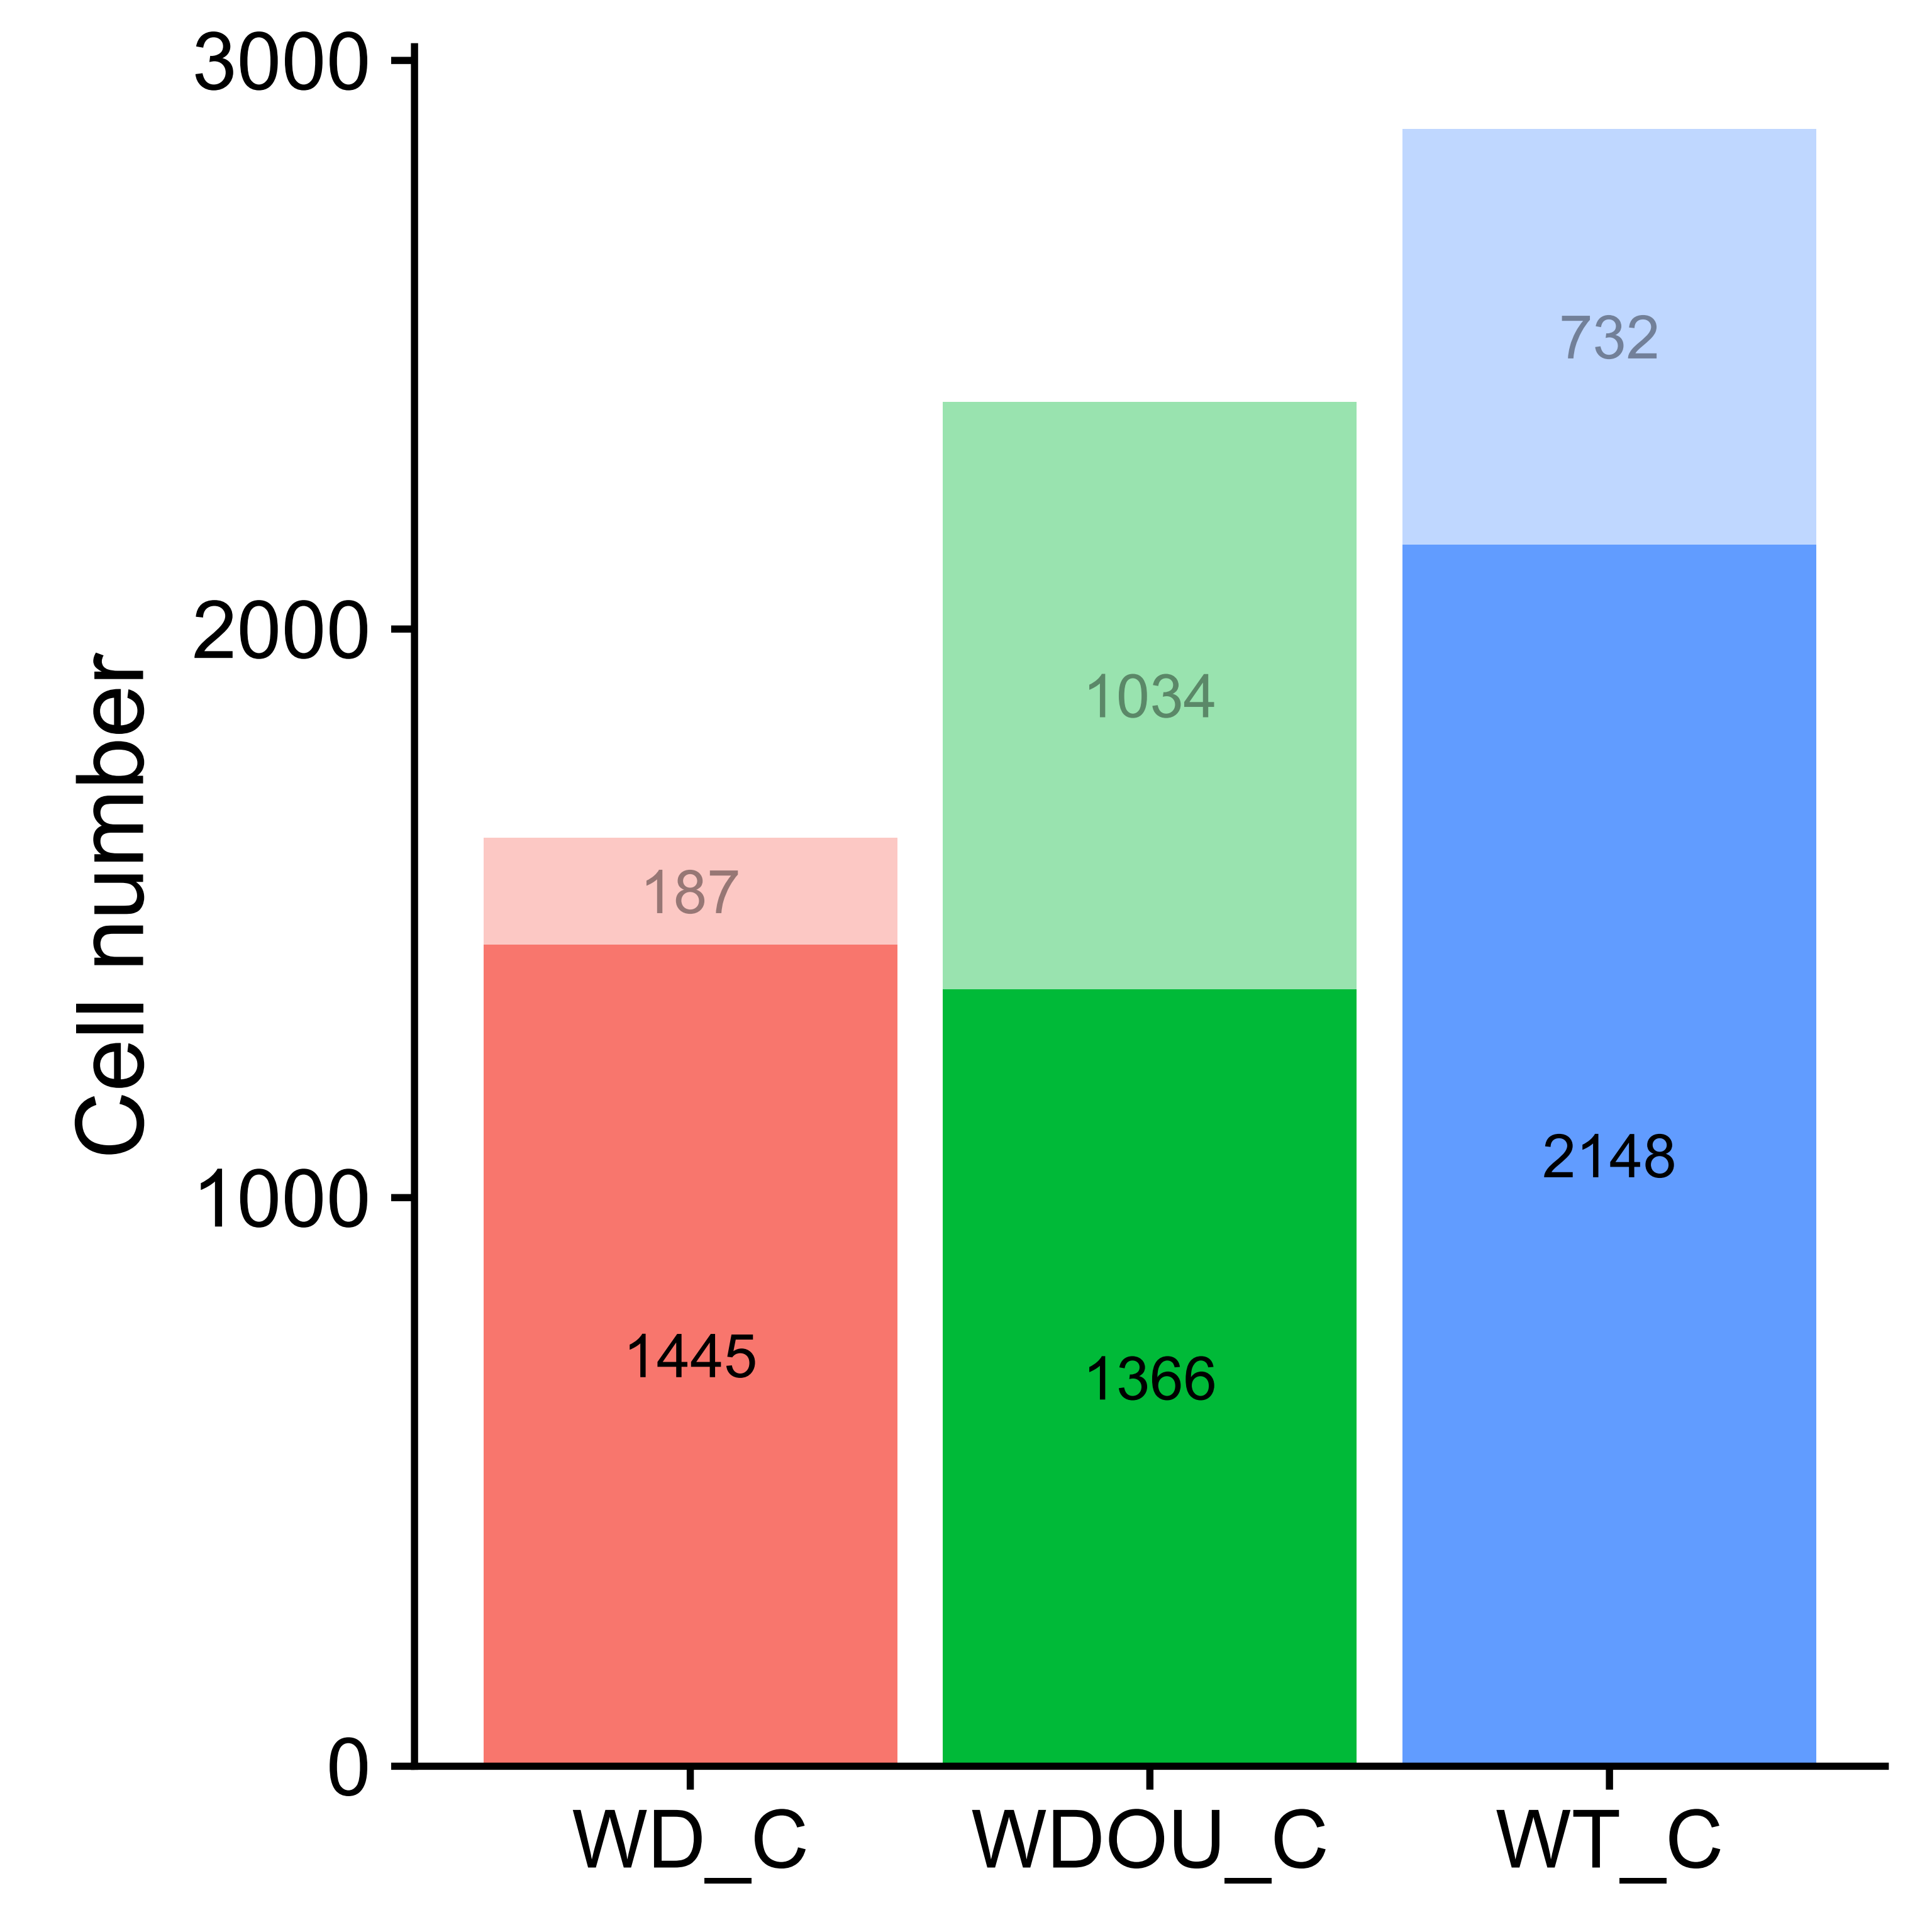
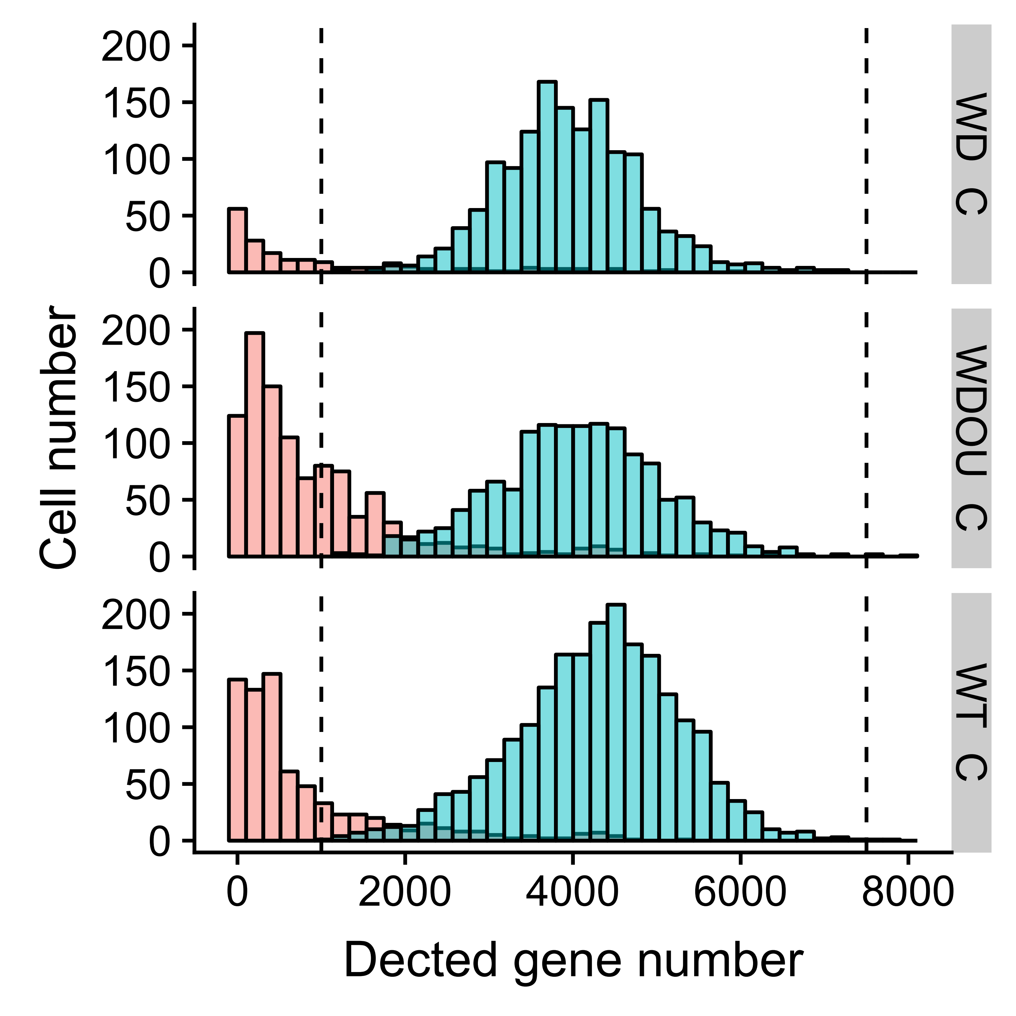
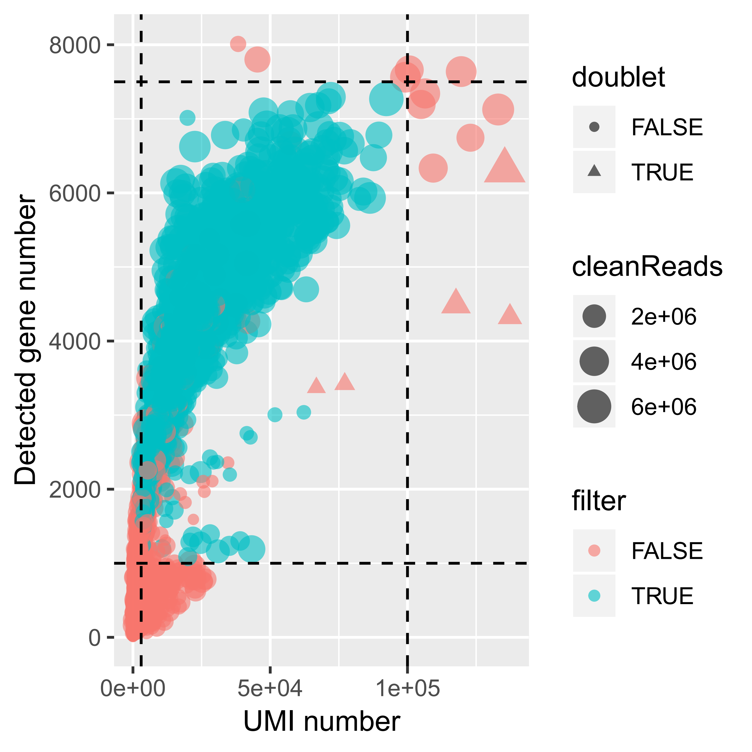
Quality control (QC) of cells in stomach
71.74% (4,959 / 6,912) of cells passed the filtering process.
For the 4,959 cells after QC:
1.96 million clean reads
4,126 detected genes
21,297 UMIs.
Notes:
4608 = 96 * 48

Slide 5
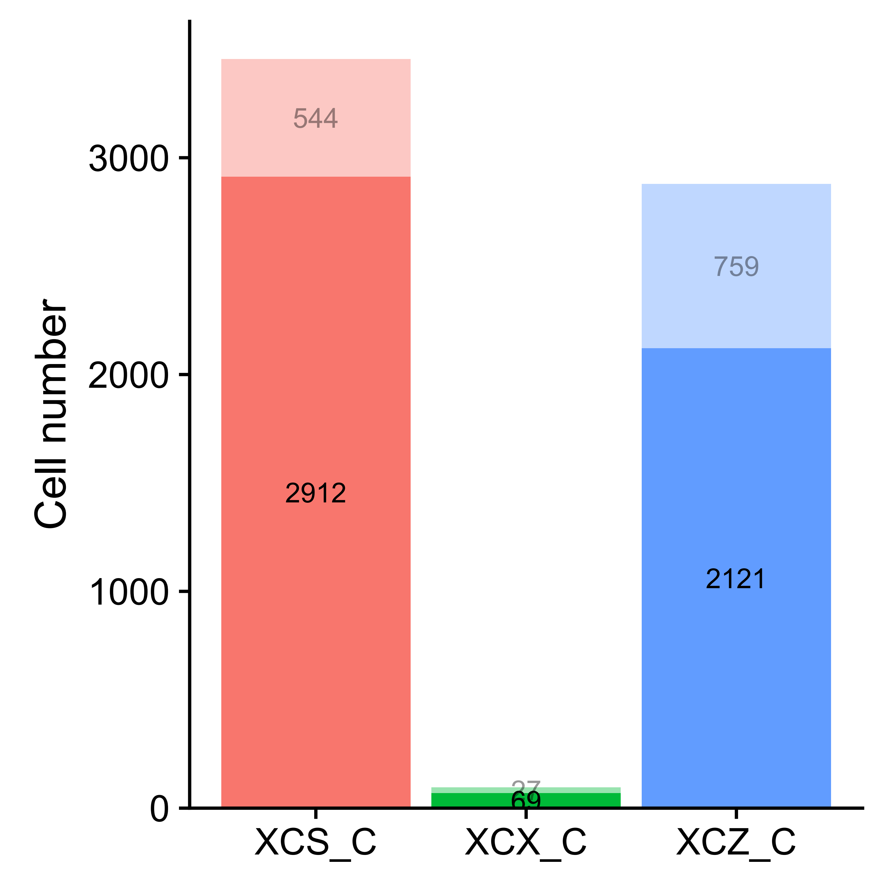
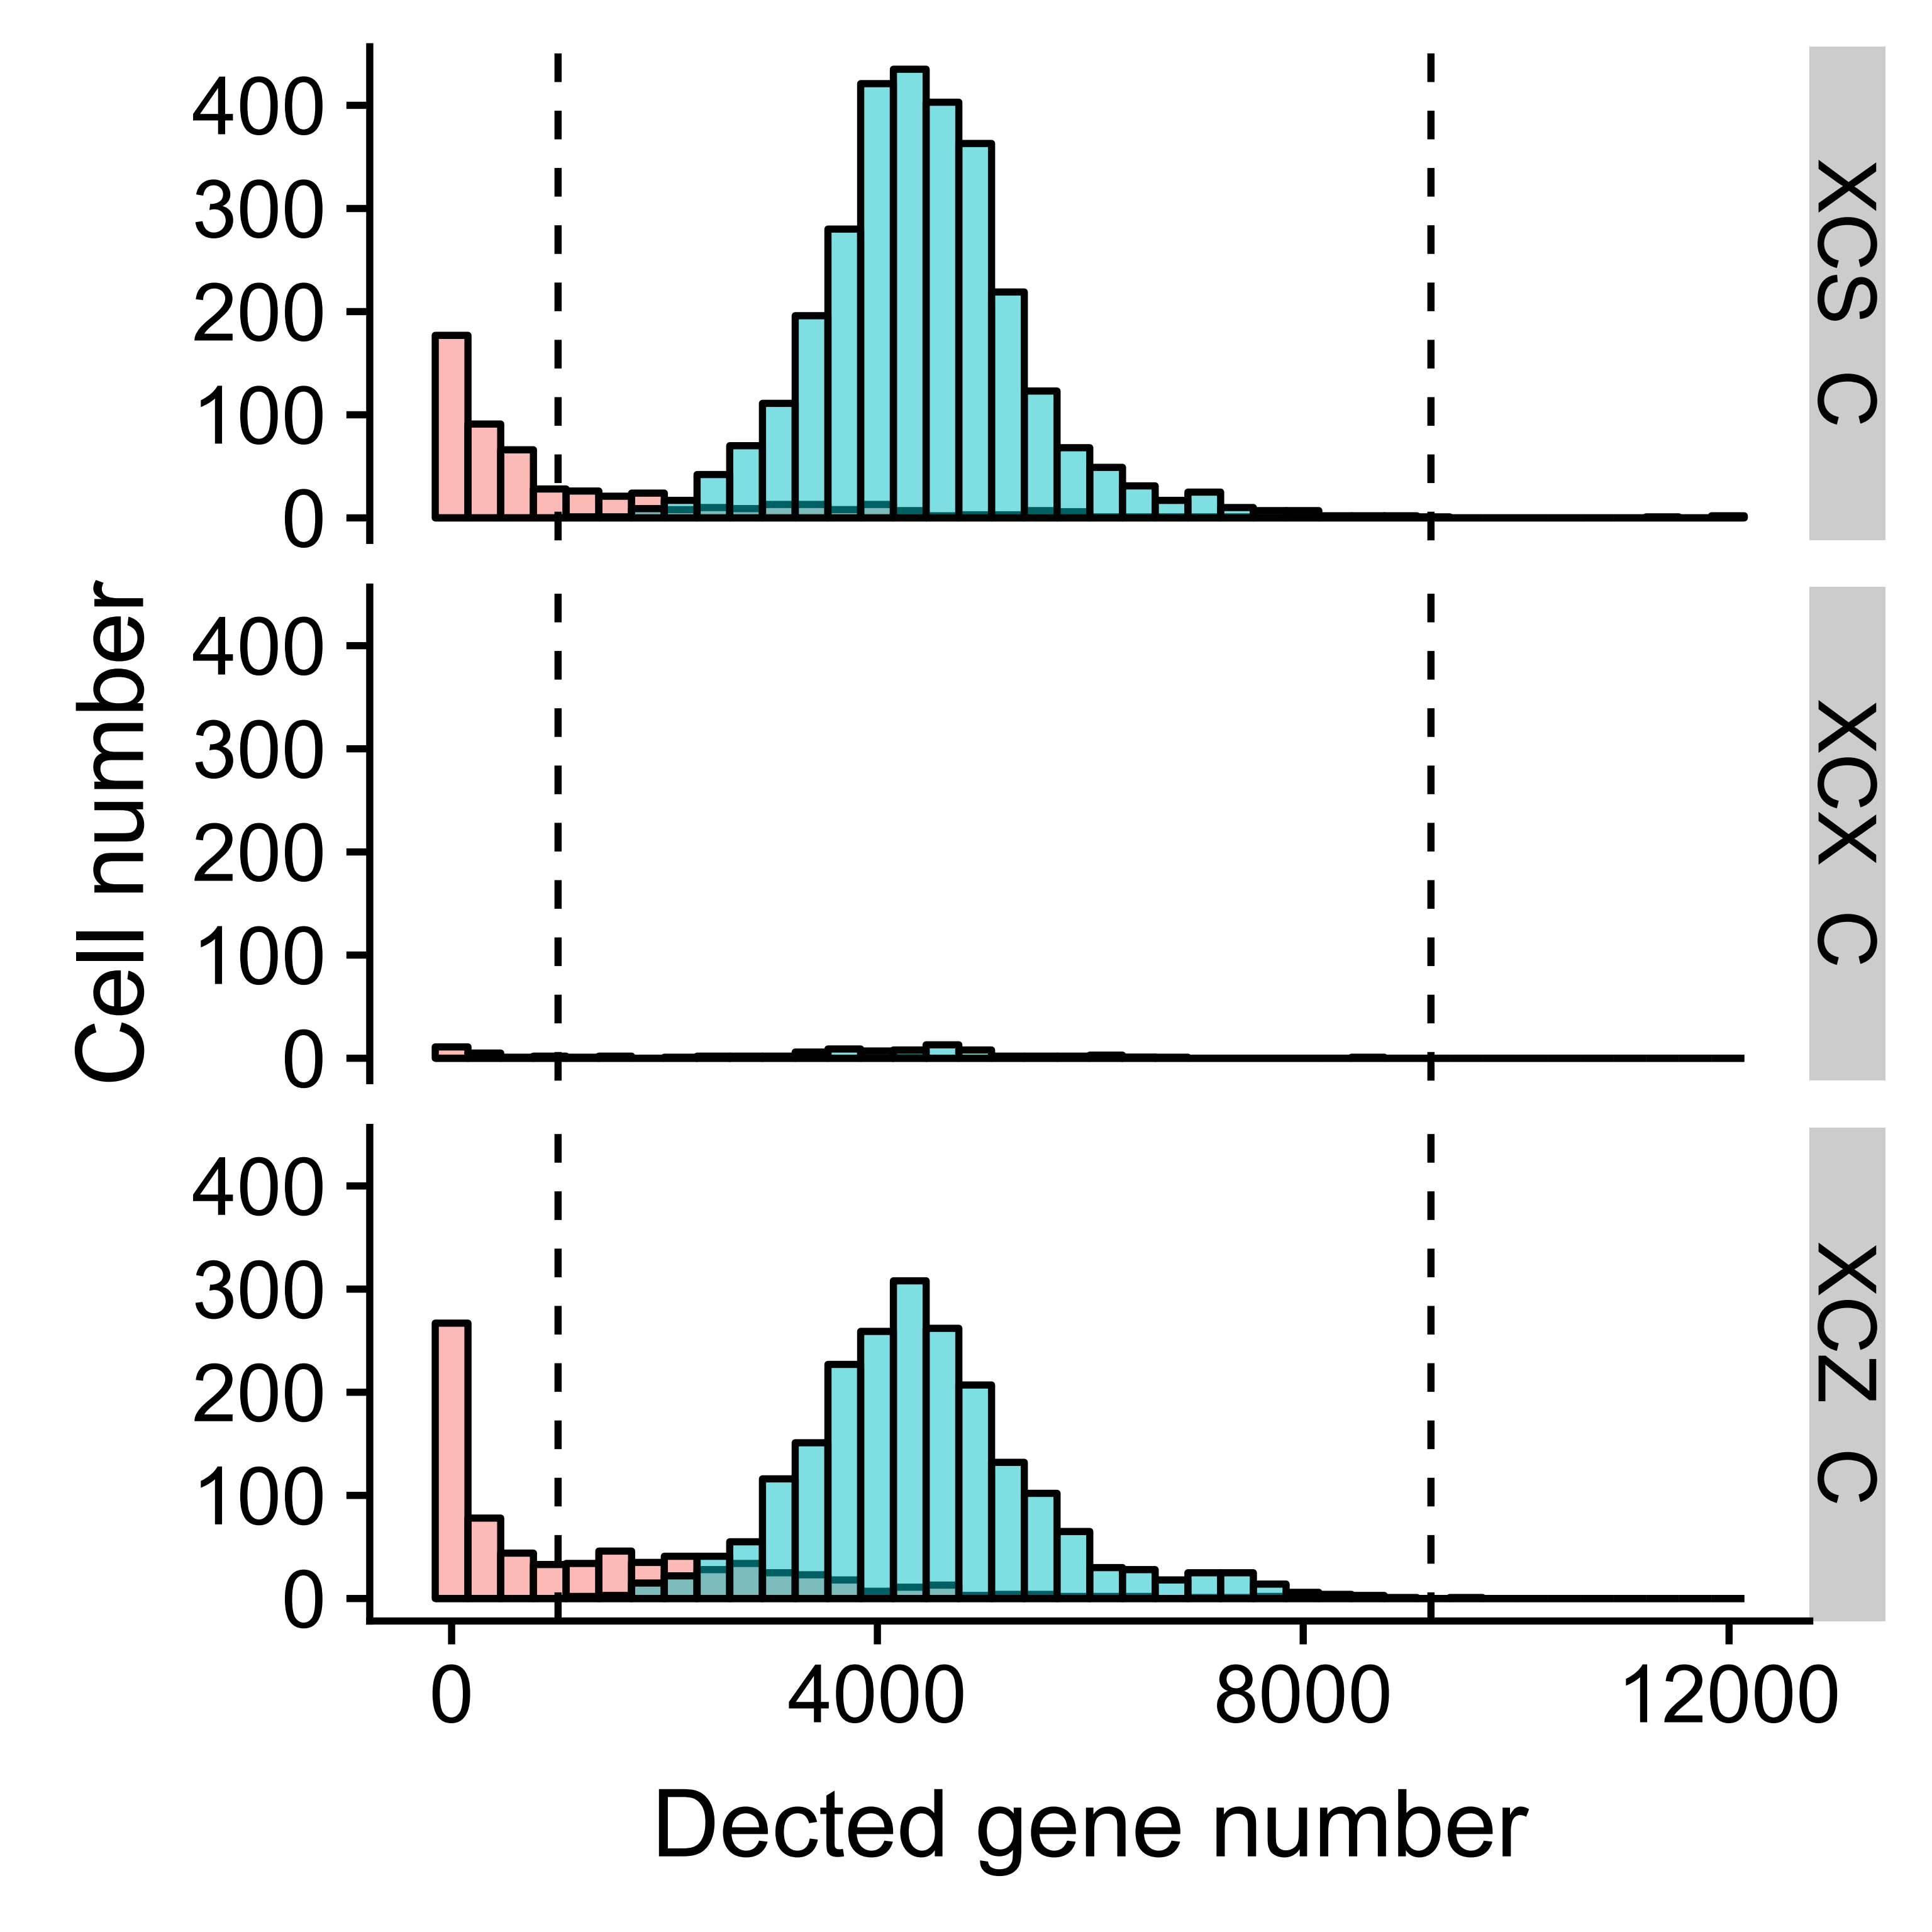
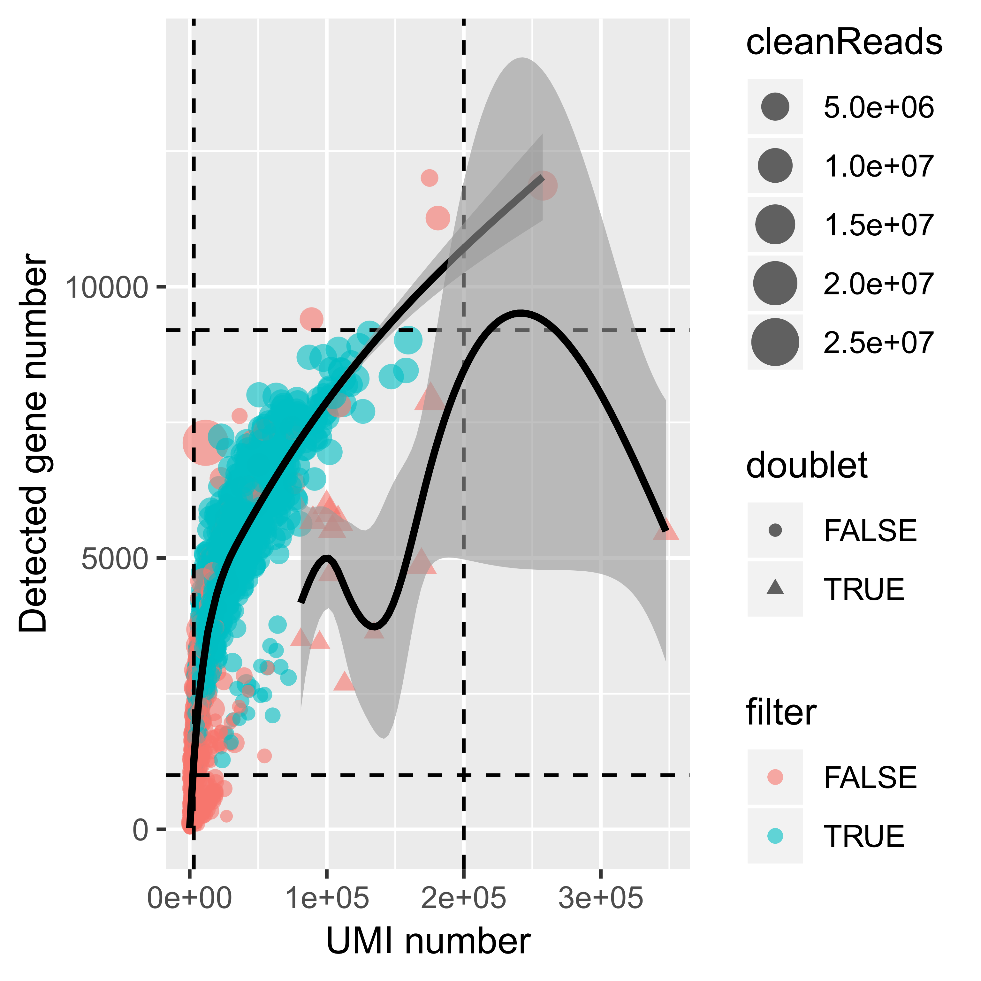
Quality control (QC) of cells in small intestinal
79.32% (5,102 / 6,432) of cells passed the filtering process.
For the 5,102 cells after QC:
1.73 million clean reads
4,406 detected genes
23,139 UMIs.
Notes:
6432 = 96 * 67

Slide 6
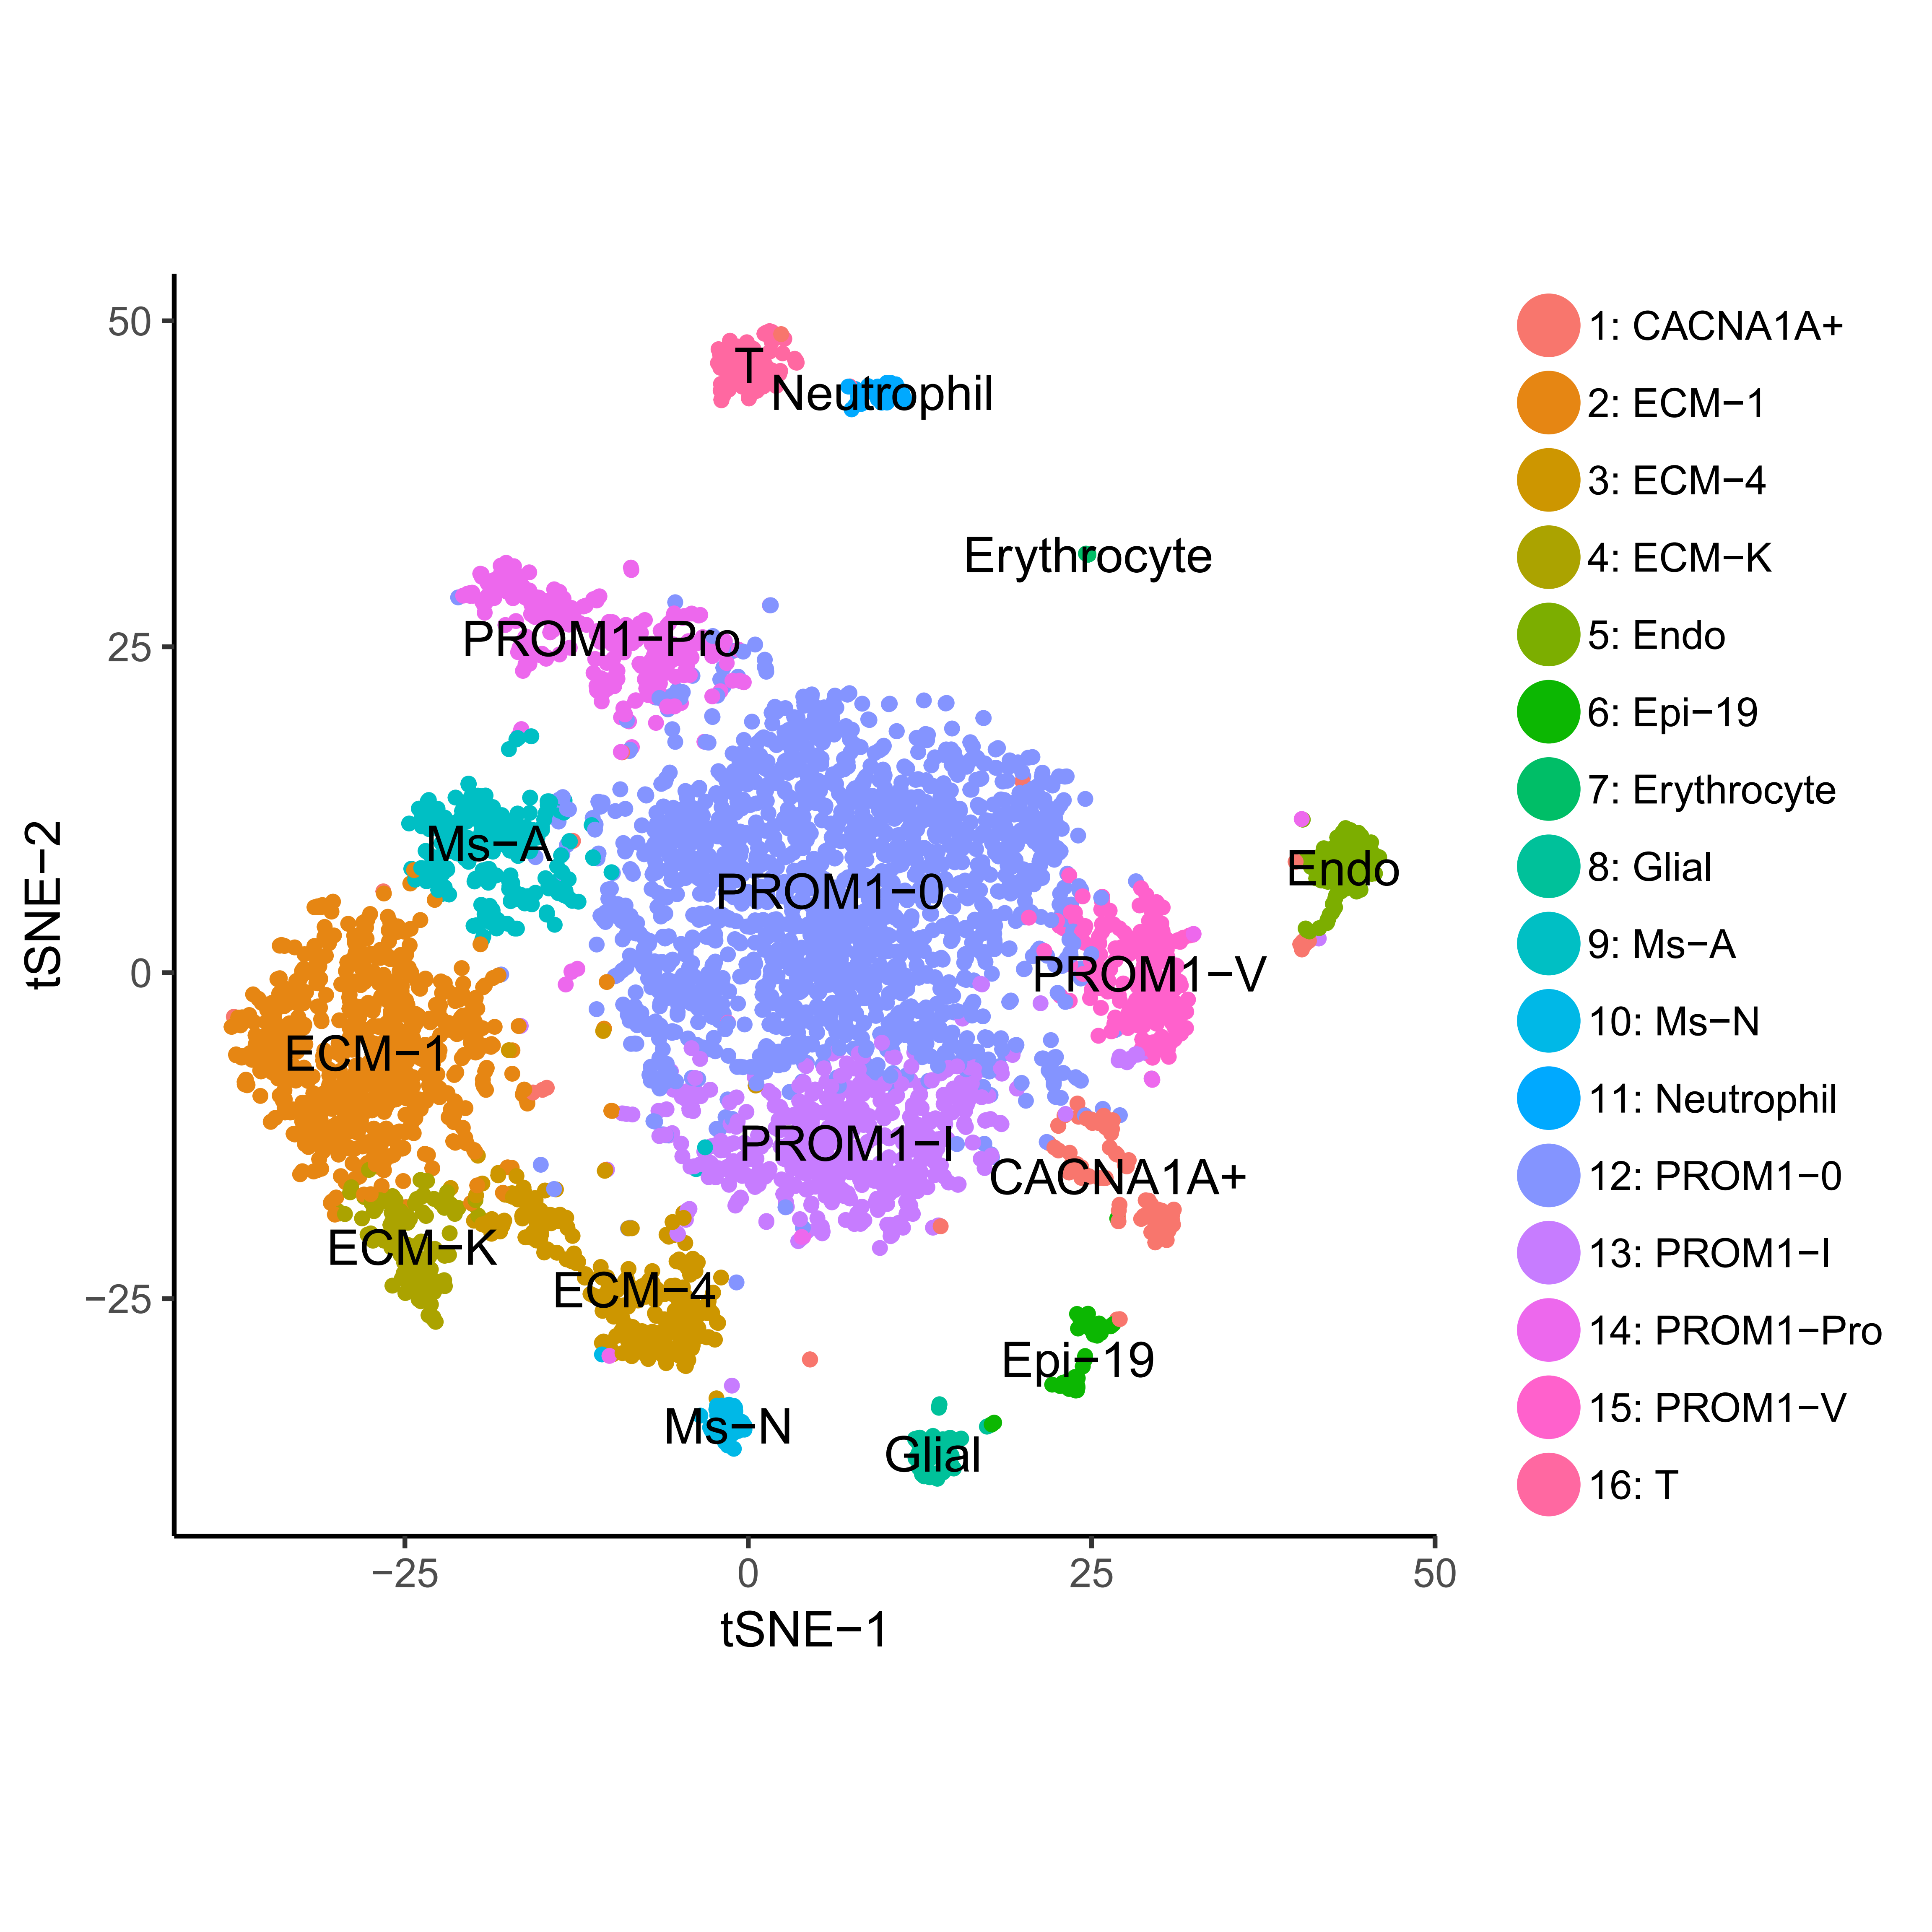
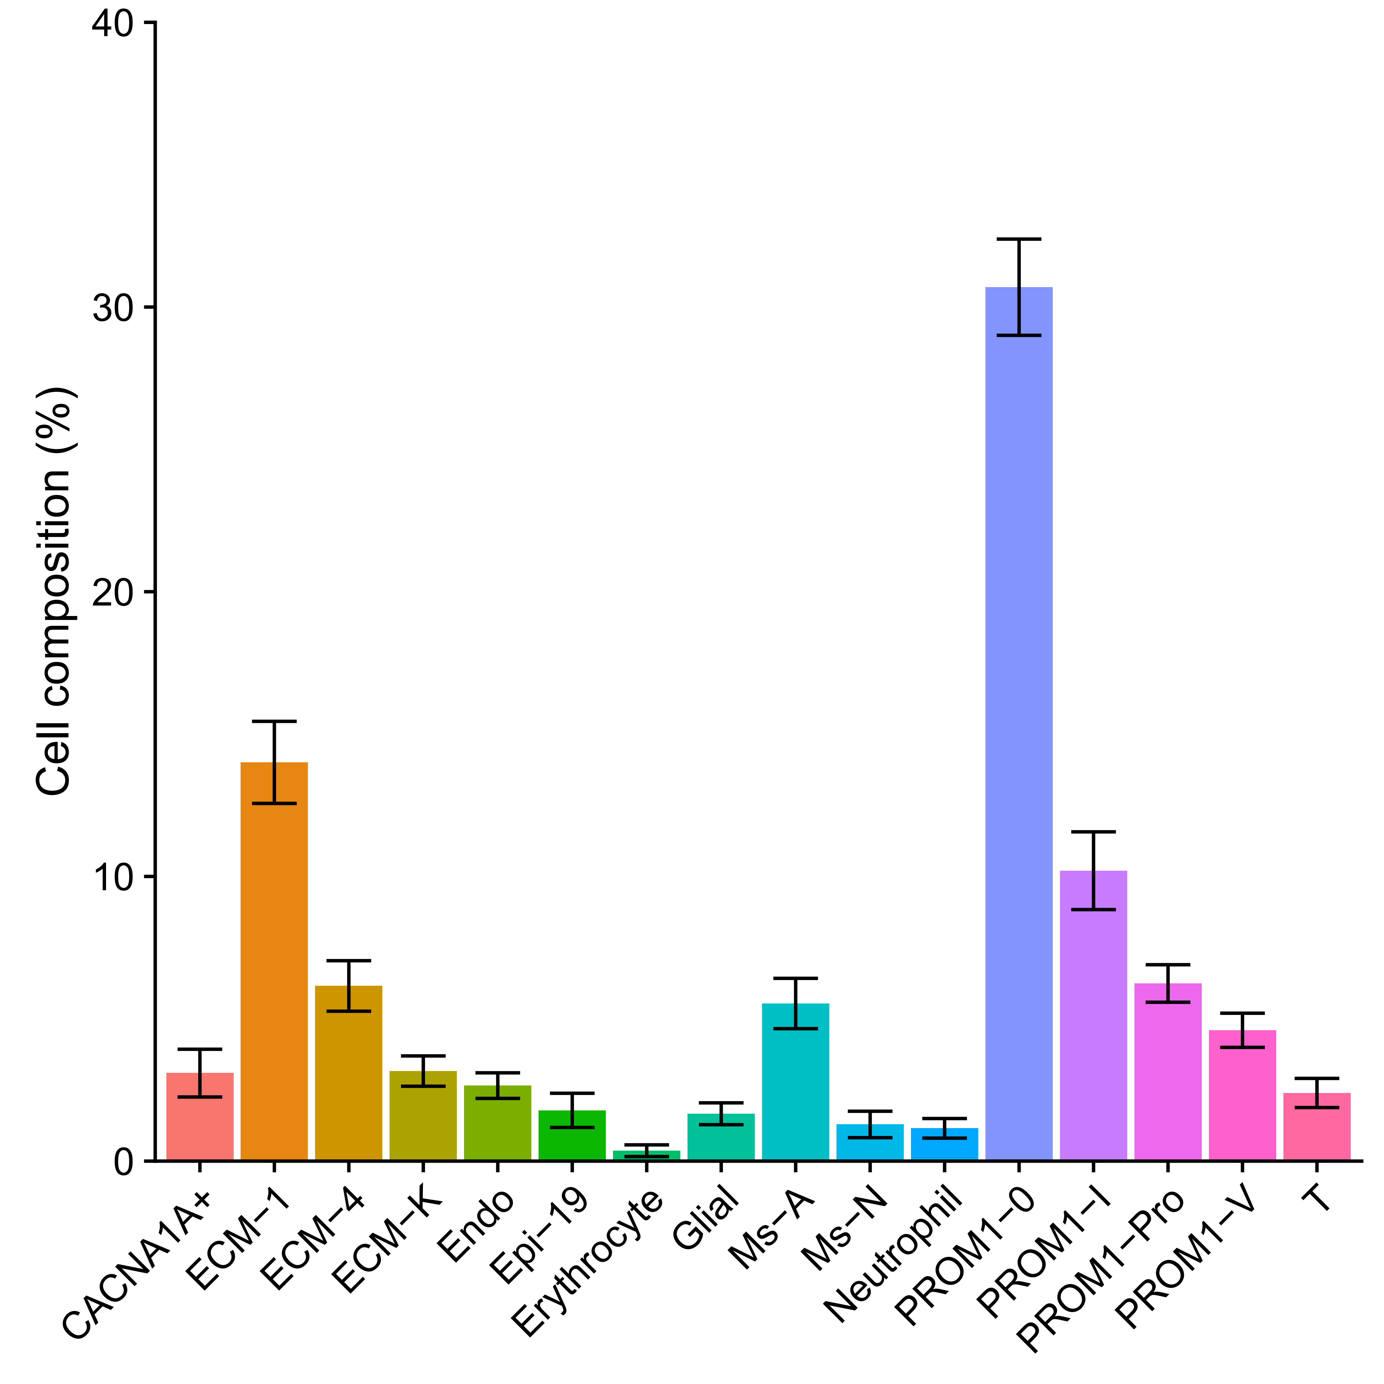
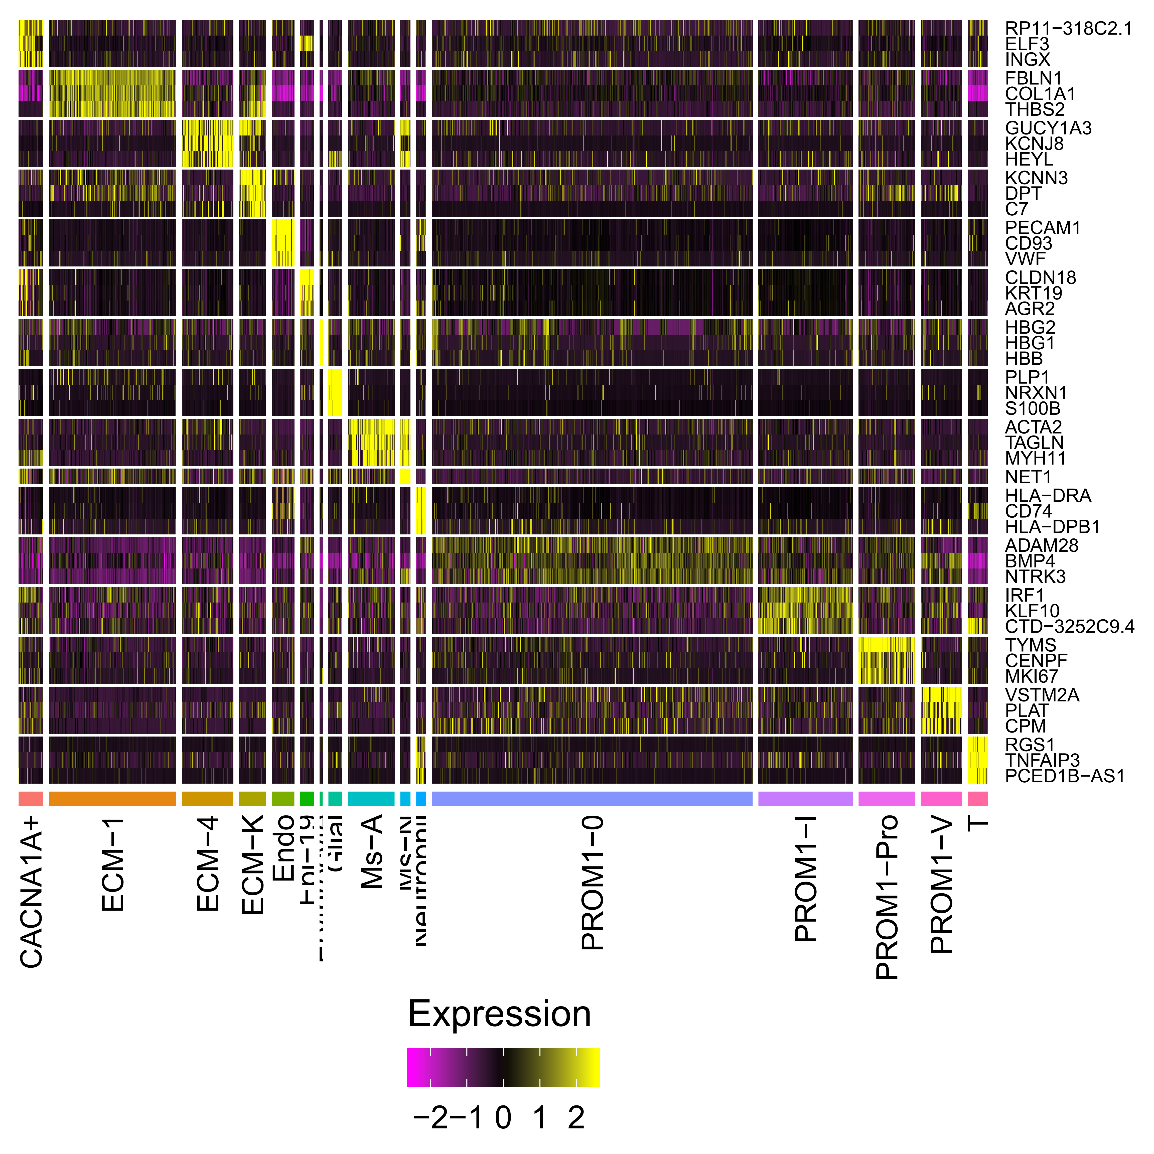
Part2: Cell type identification and annotation
A
Other tissues.

Slide 7
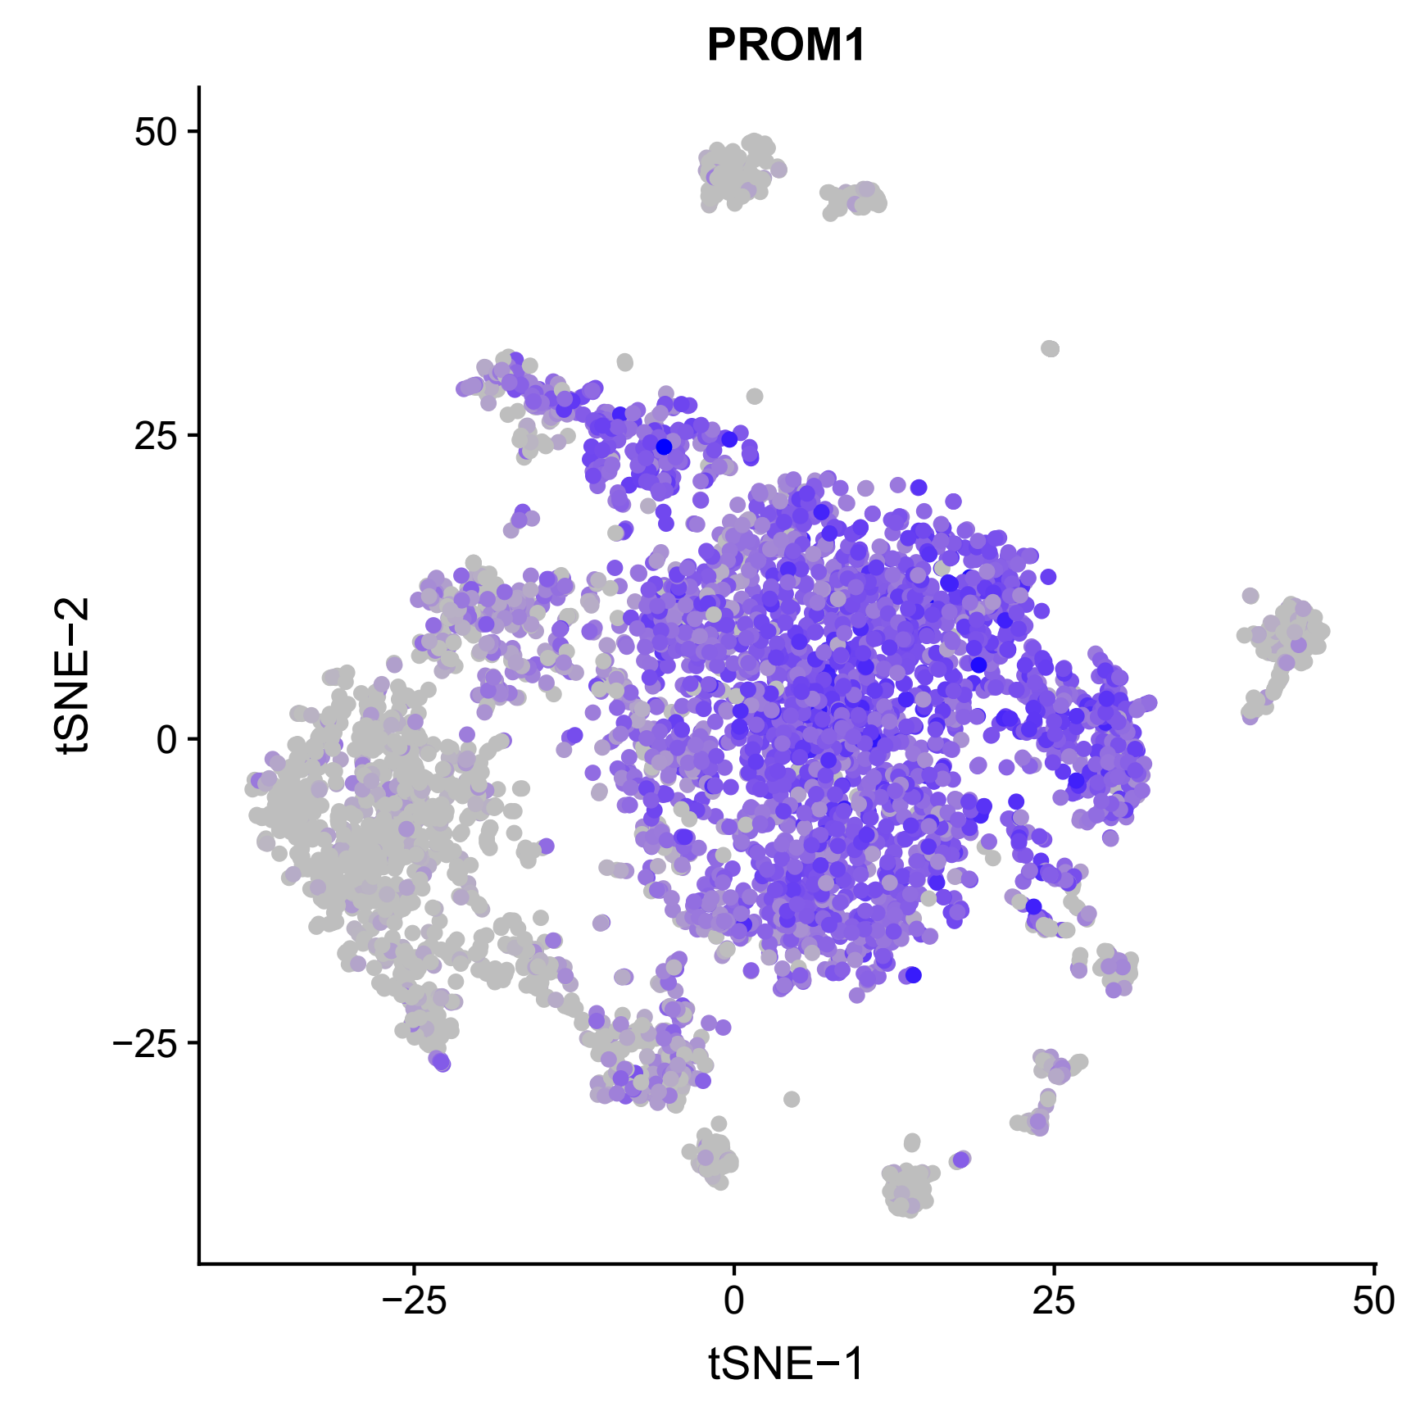
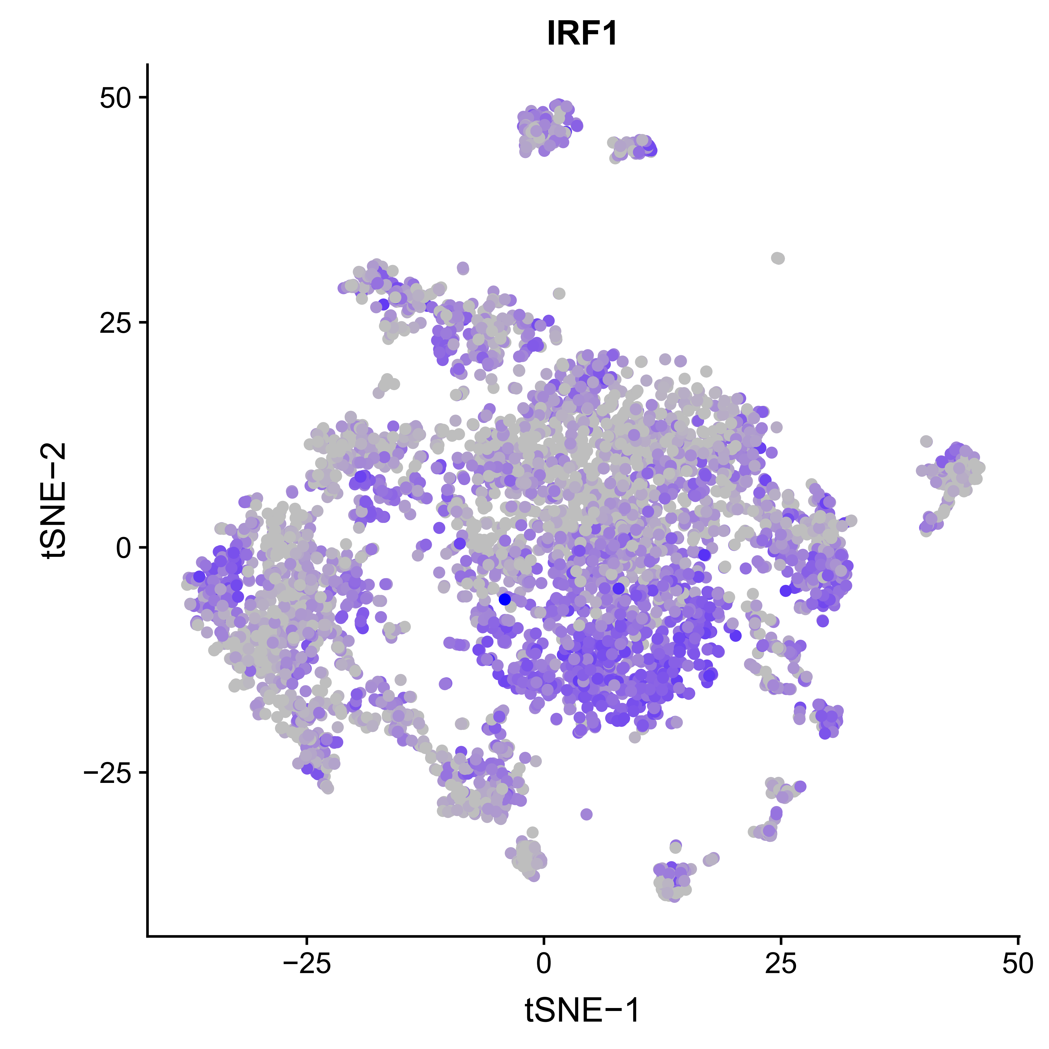
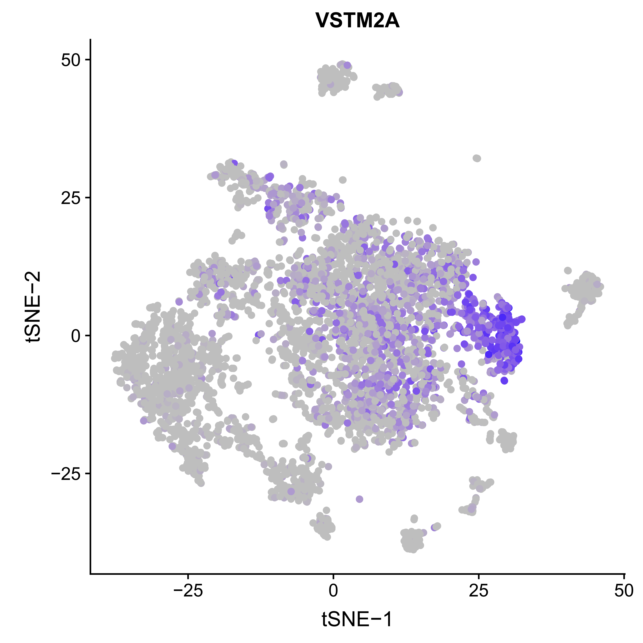
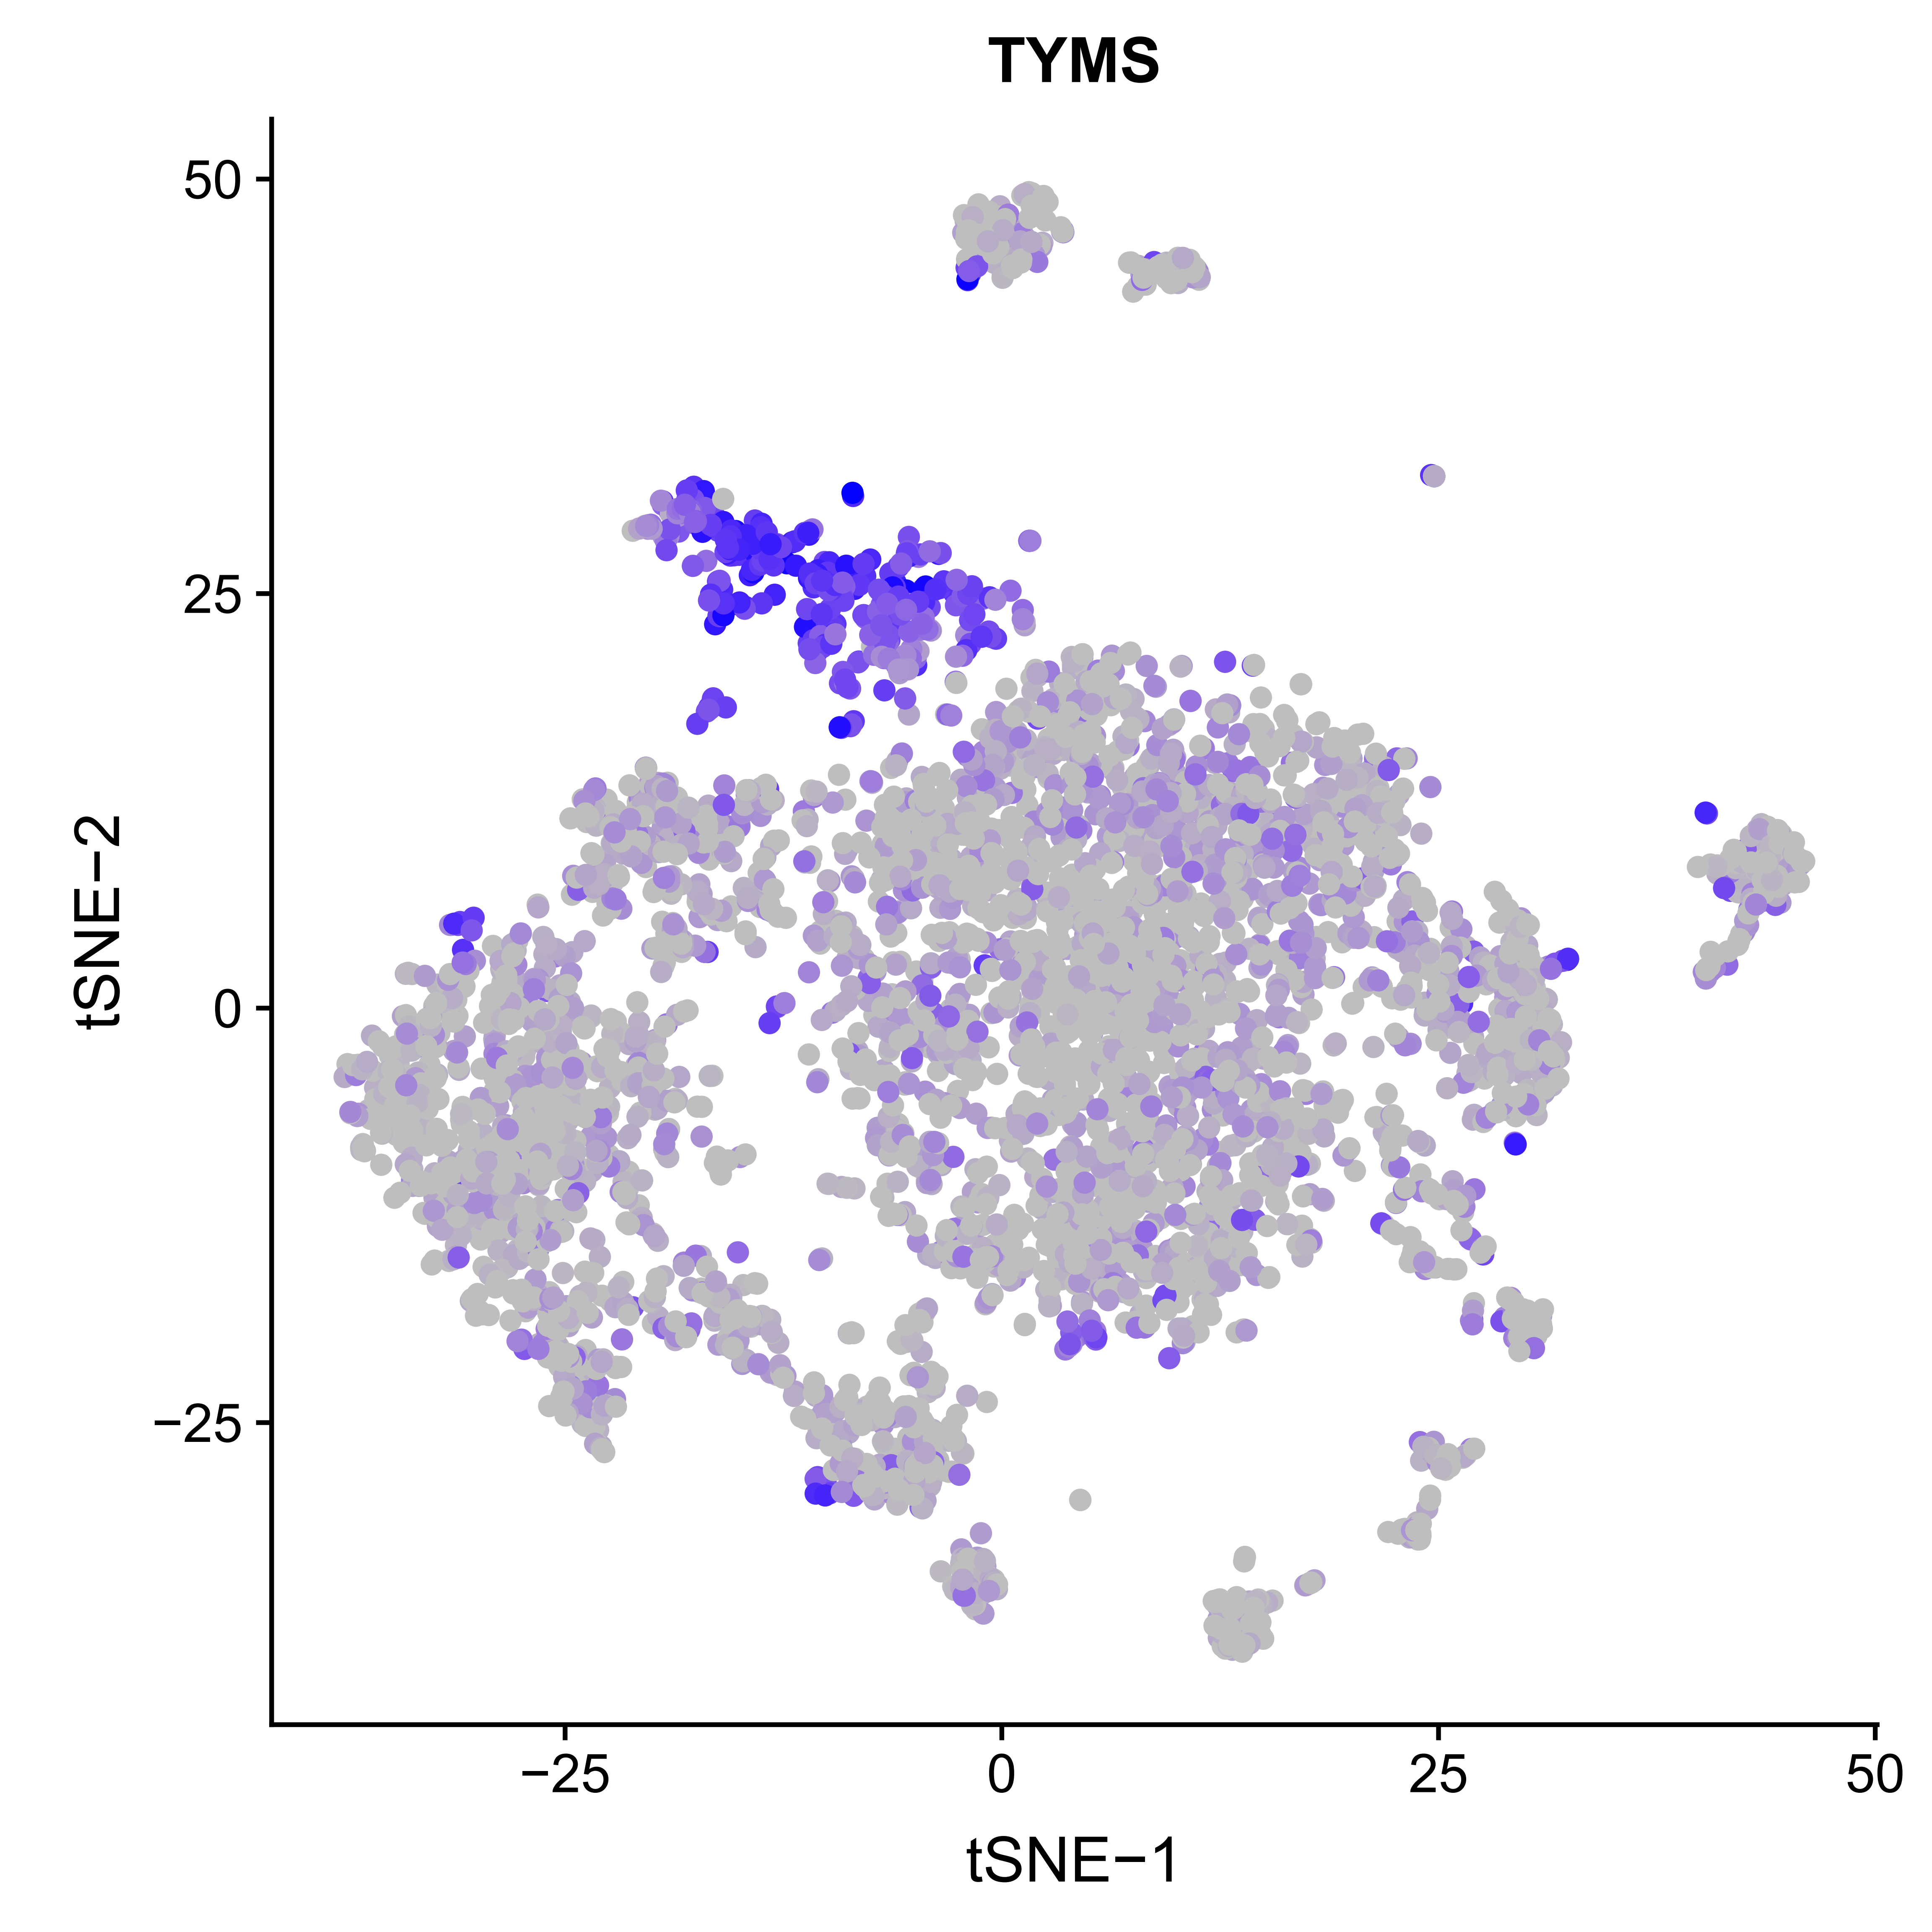
Stomach: cell type identification
A
B
Erythrocyte
C

Slide 8
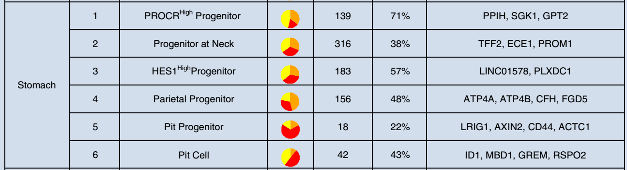
Stomach: cell type identification
Cell clustering: 98 cells in 24-week

Slide 9
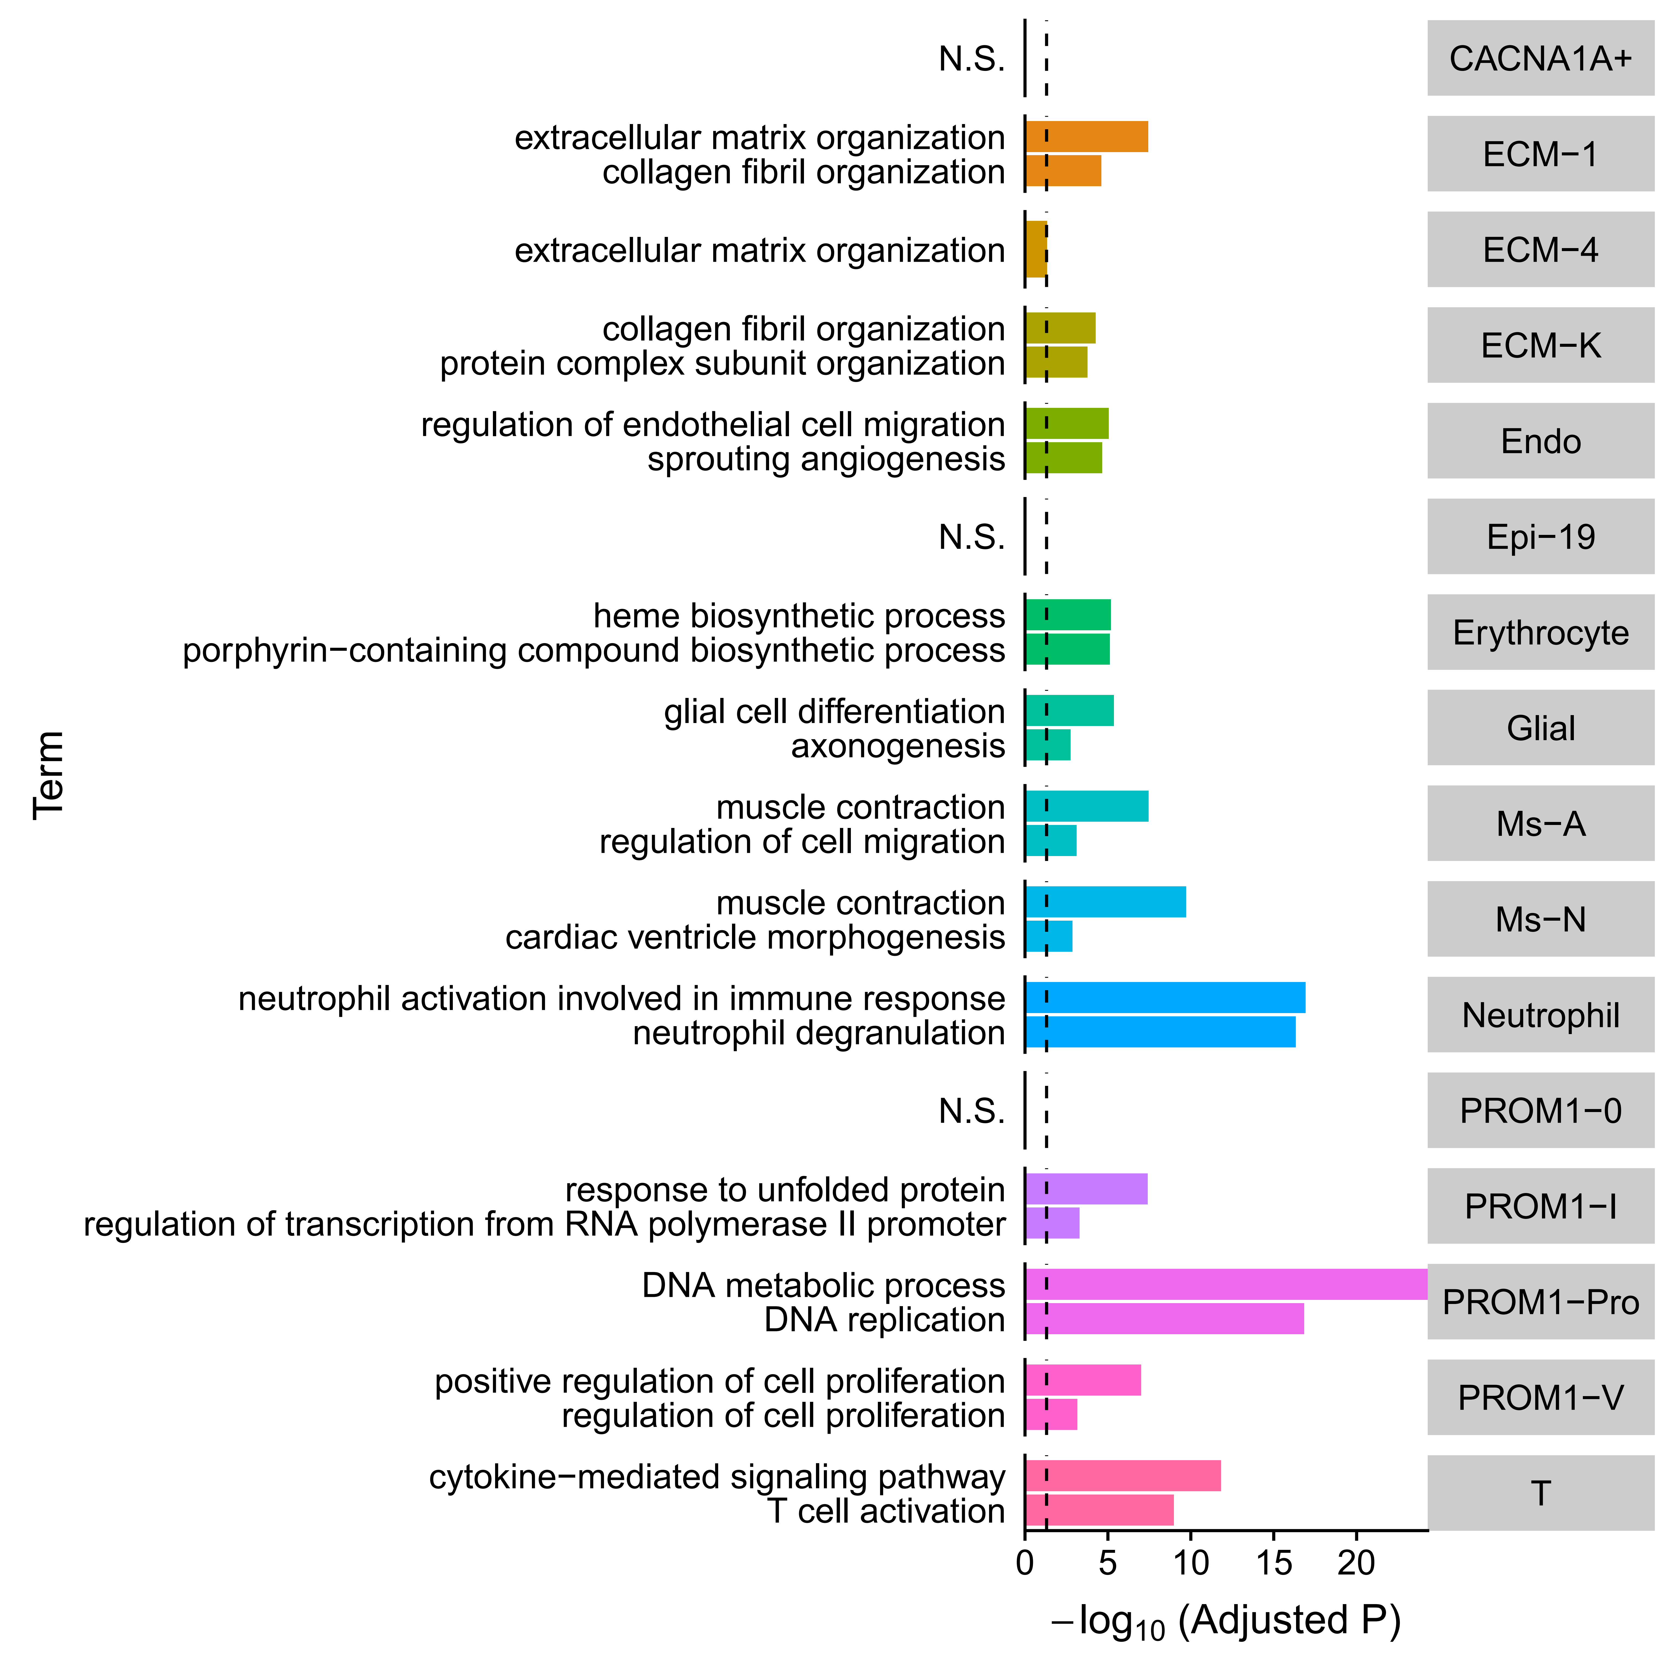
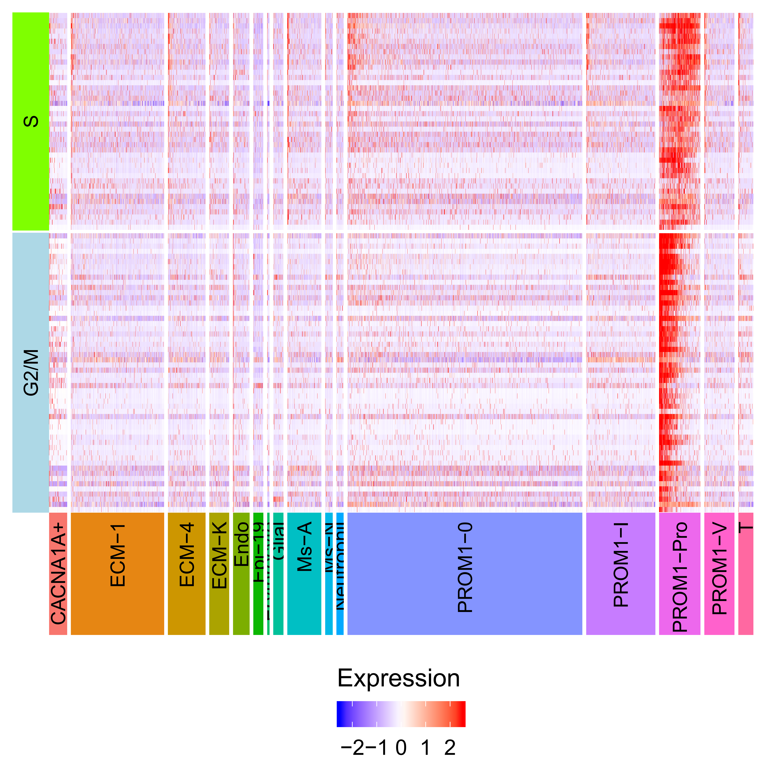
Stomach: cell type annotation

Slide 10
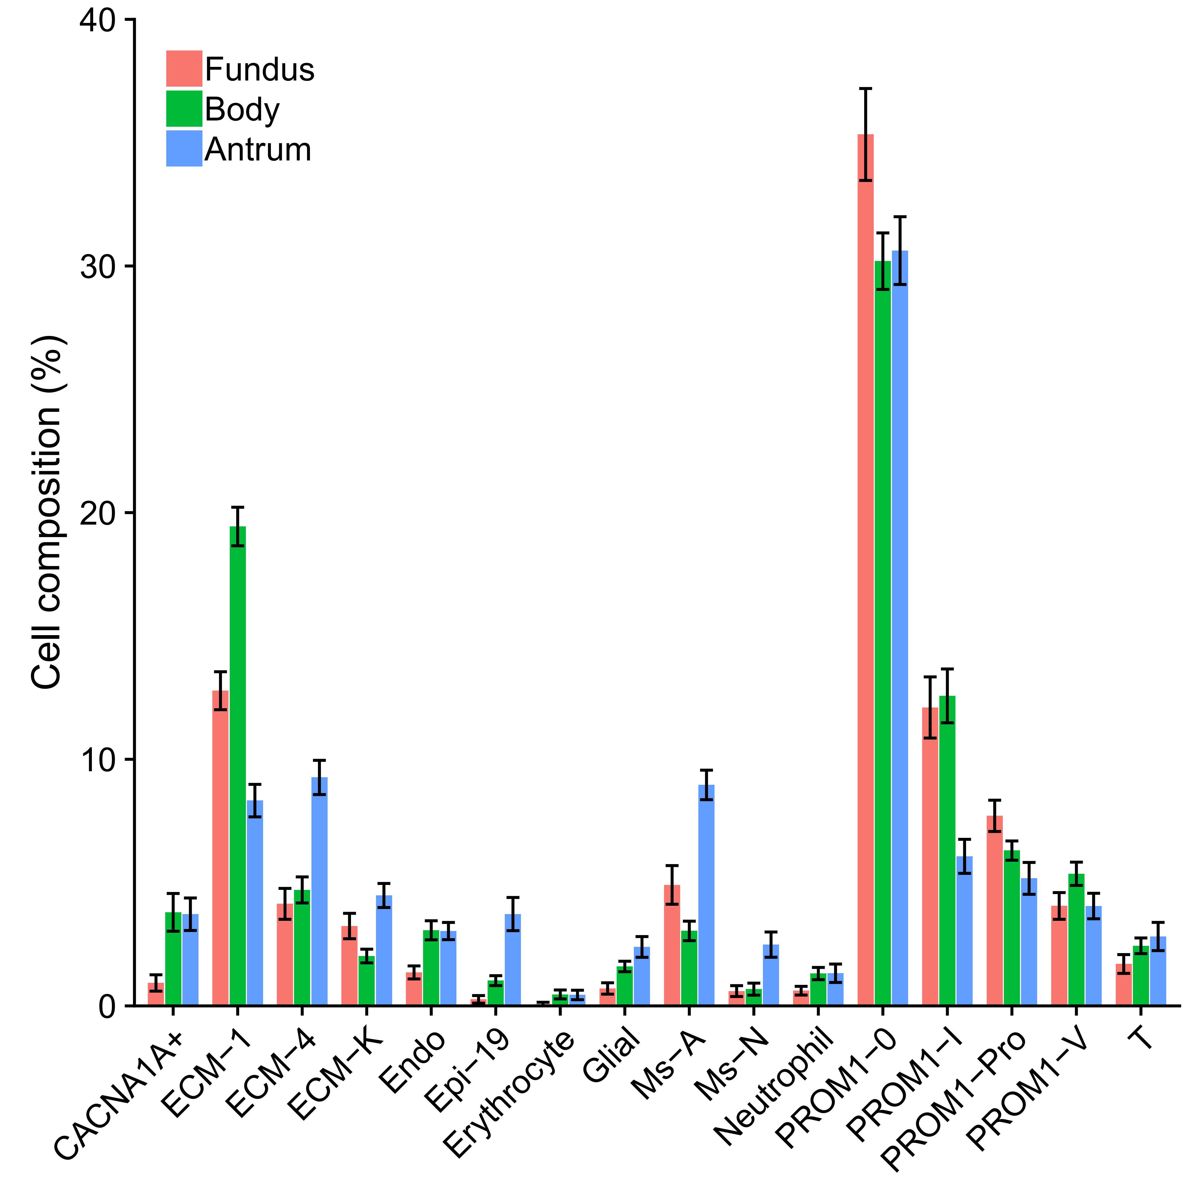
Stomach: cell composition

Slide 11
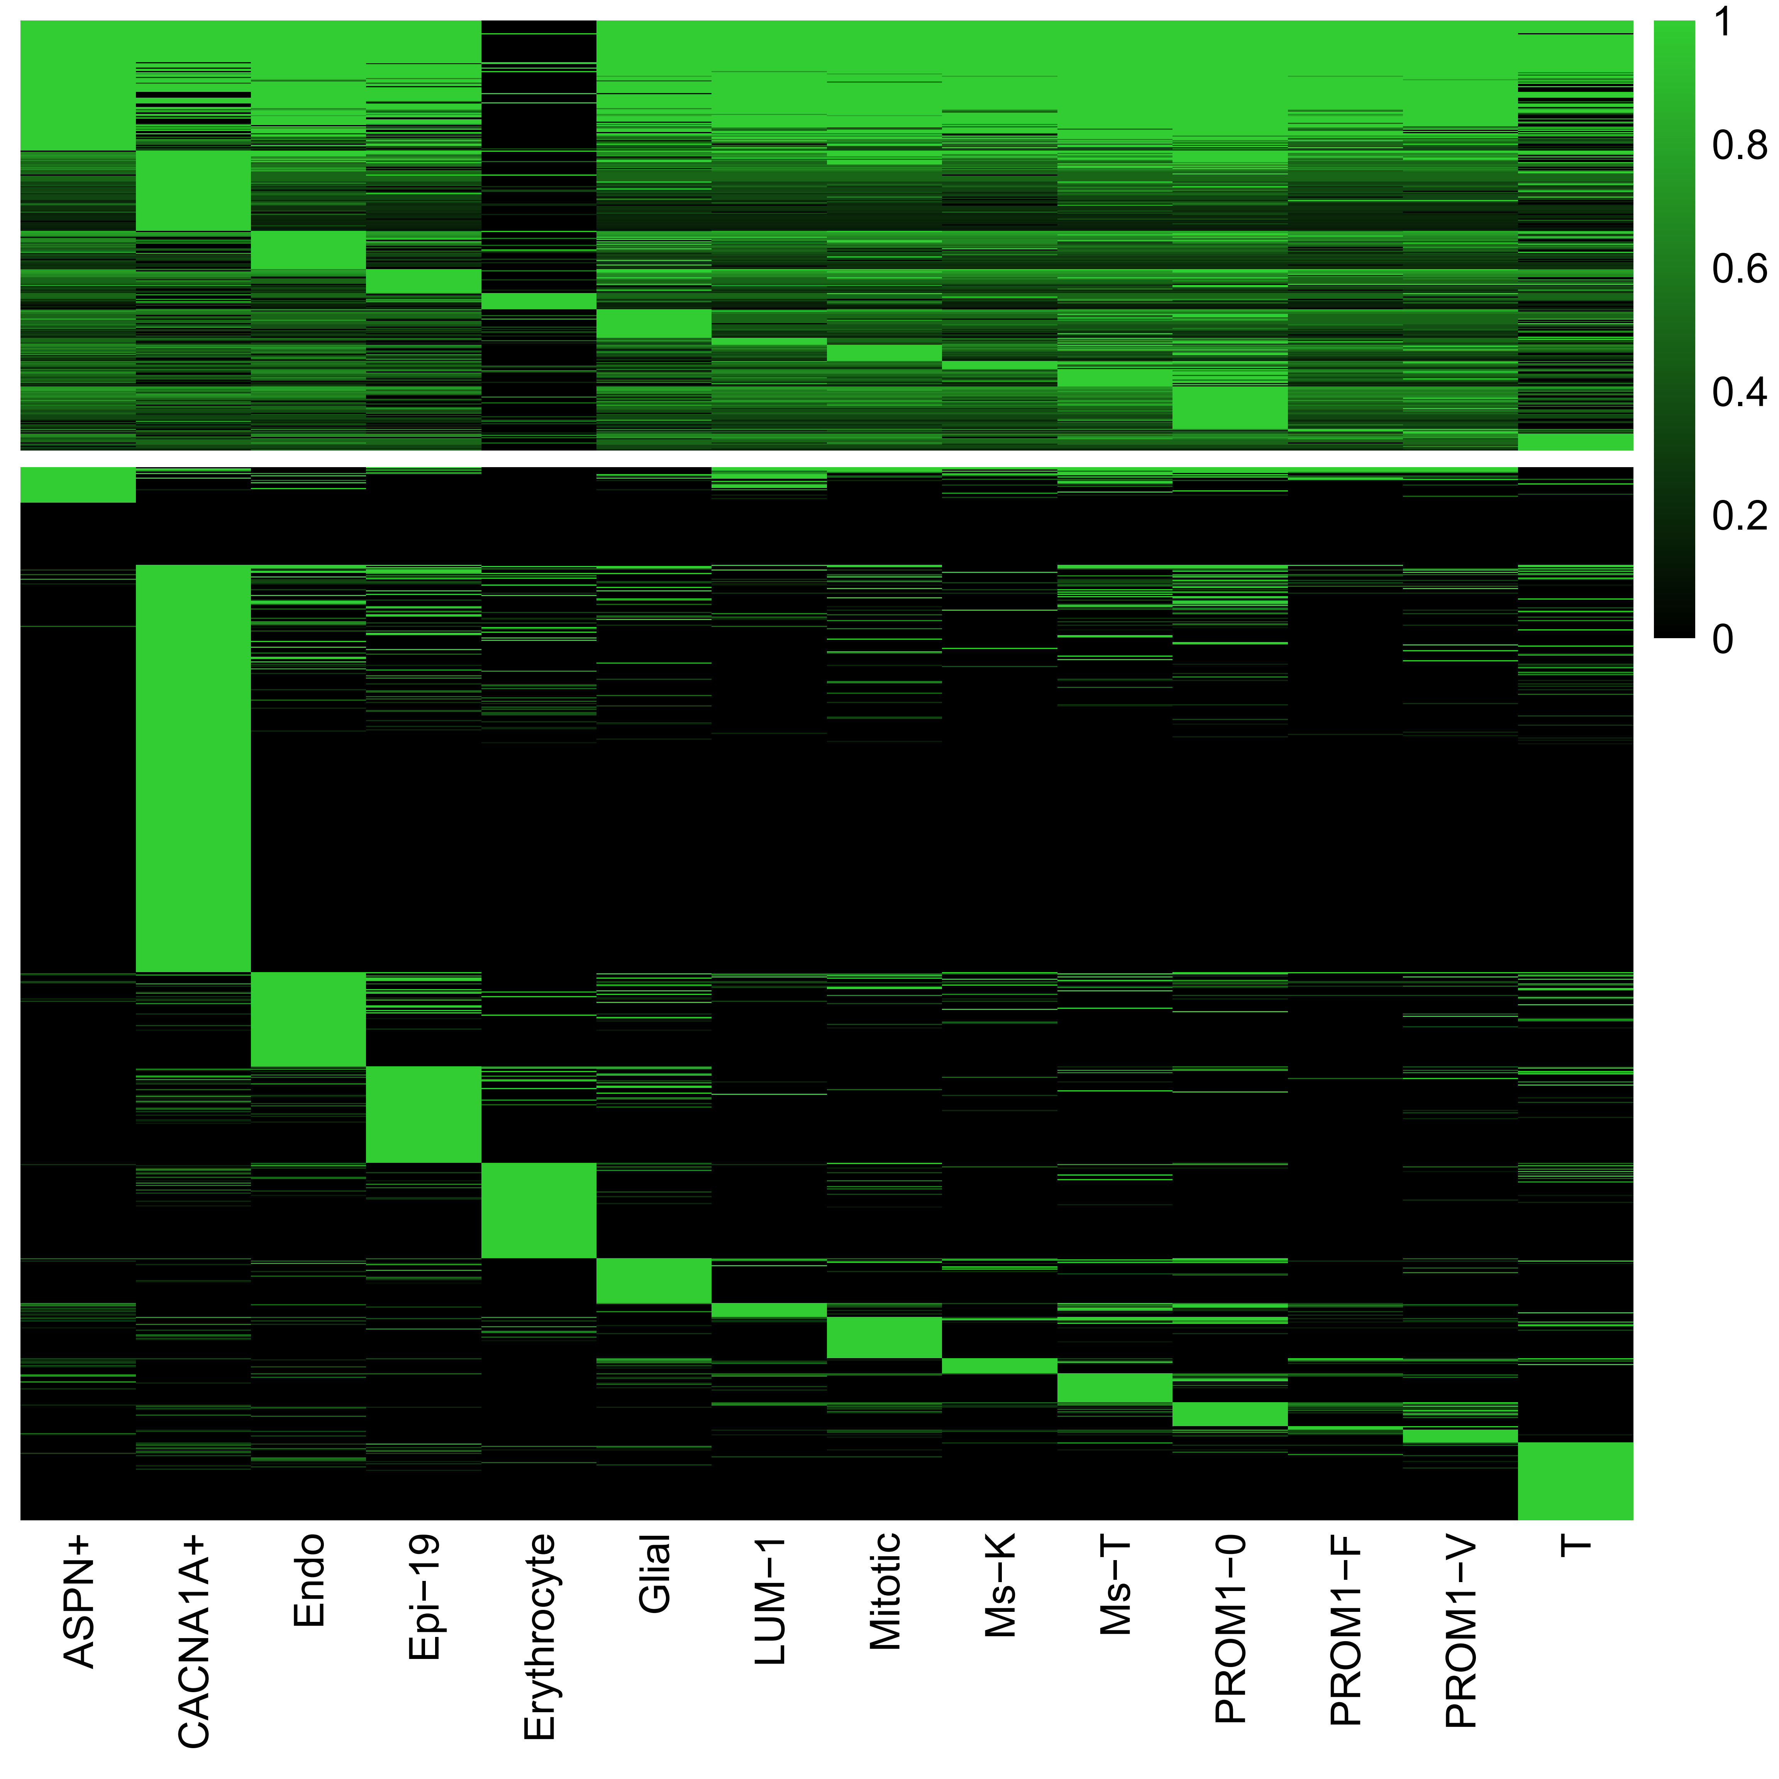
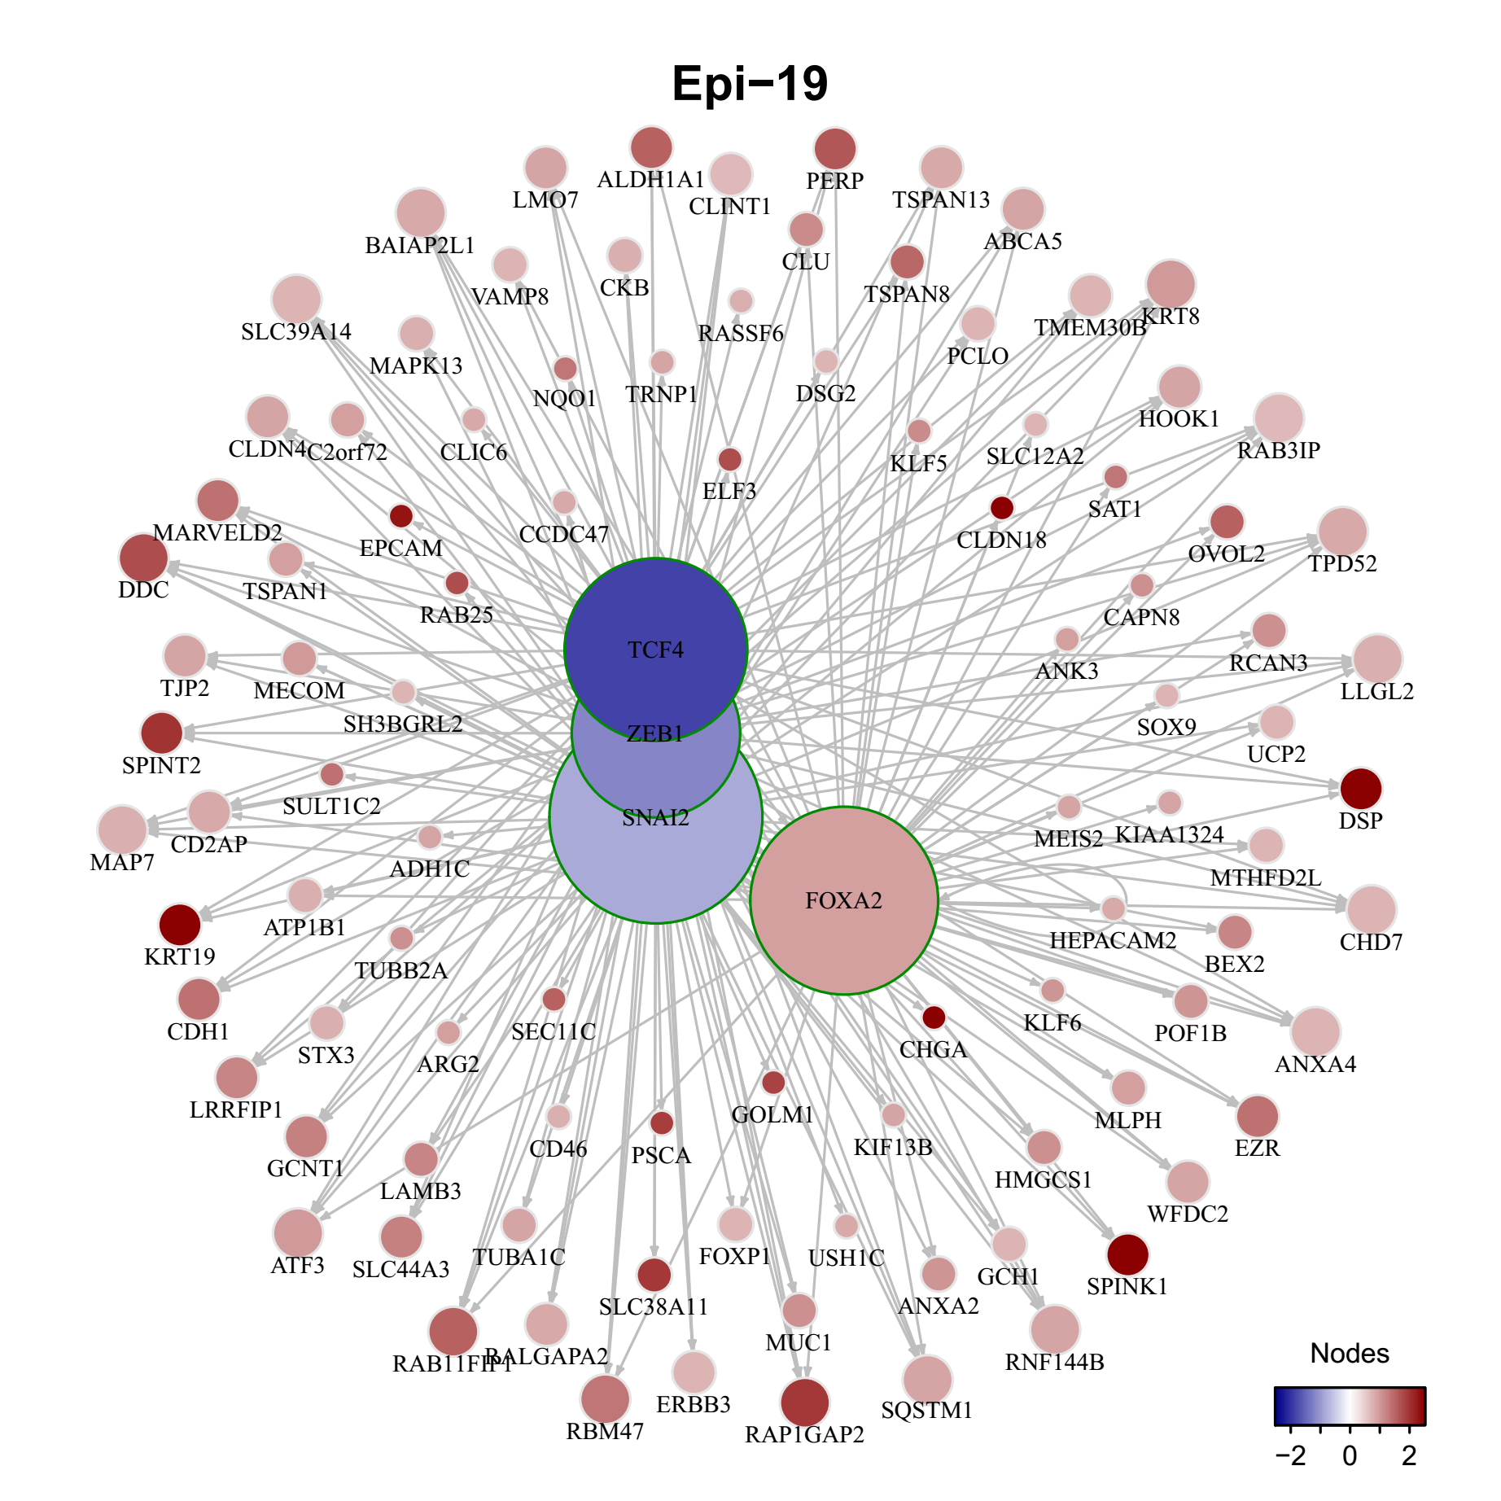
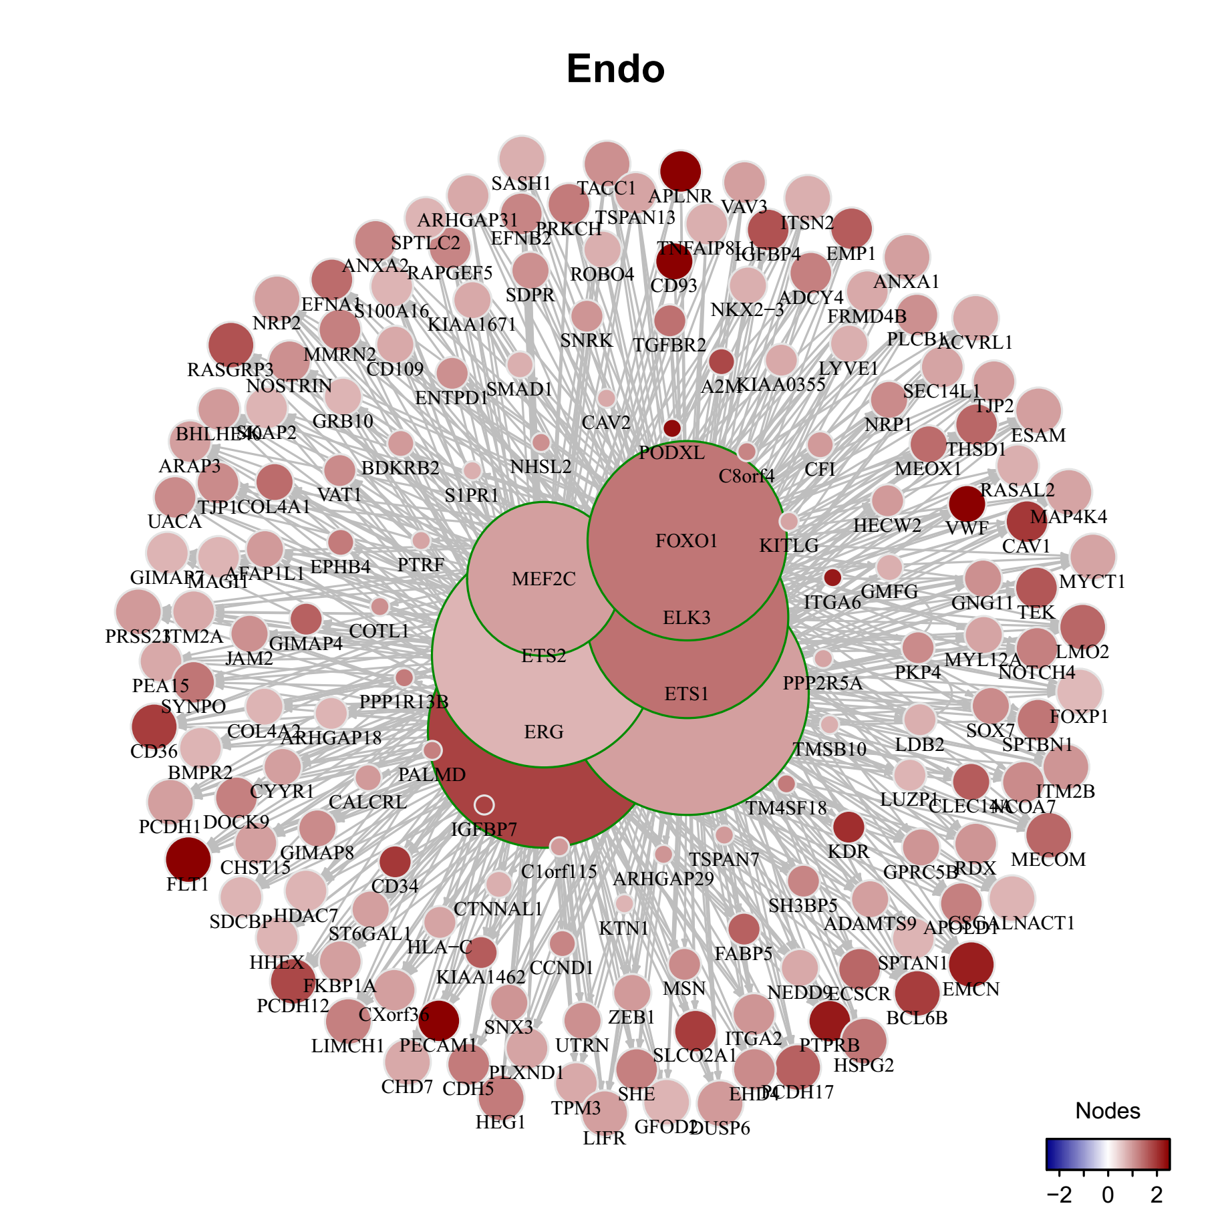
Part3: Transcriptional regulation across cell-types
A
B
Evolutionary ages / families for each type of TFs
C
D
Notes:
module gene ctype cellNum
ASPN+ 178 4113 ASPN+ 142
CACNA1A+ 265 5054 CACNA1A+ 88
Endo 235 5968 Endo 89
Epi-19 364 8822 Epi-19 63
Erythrocyte 98 9018 Erythrocyte 15
Glial 312 6514 Glial 66
LUM-1 120 2033 LUM-1 485
Mitotic 197 4038 Mitotic 177
Ms-K 187 3763 Ms-K 184
Ms-T 198 3840 Ms-T 187
PROM1-0 41 643 PROM1-0 991
PROM1-F 138 2299 PROM1-F 344
PROM1-V 191 4116 PROM1-V 140
T 231 5236 T 121

Slide 12
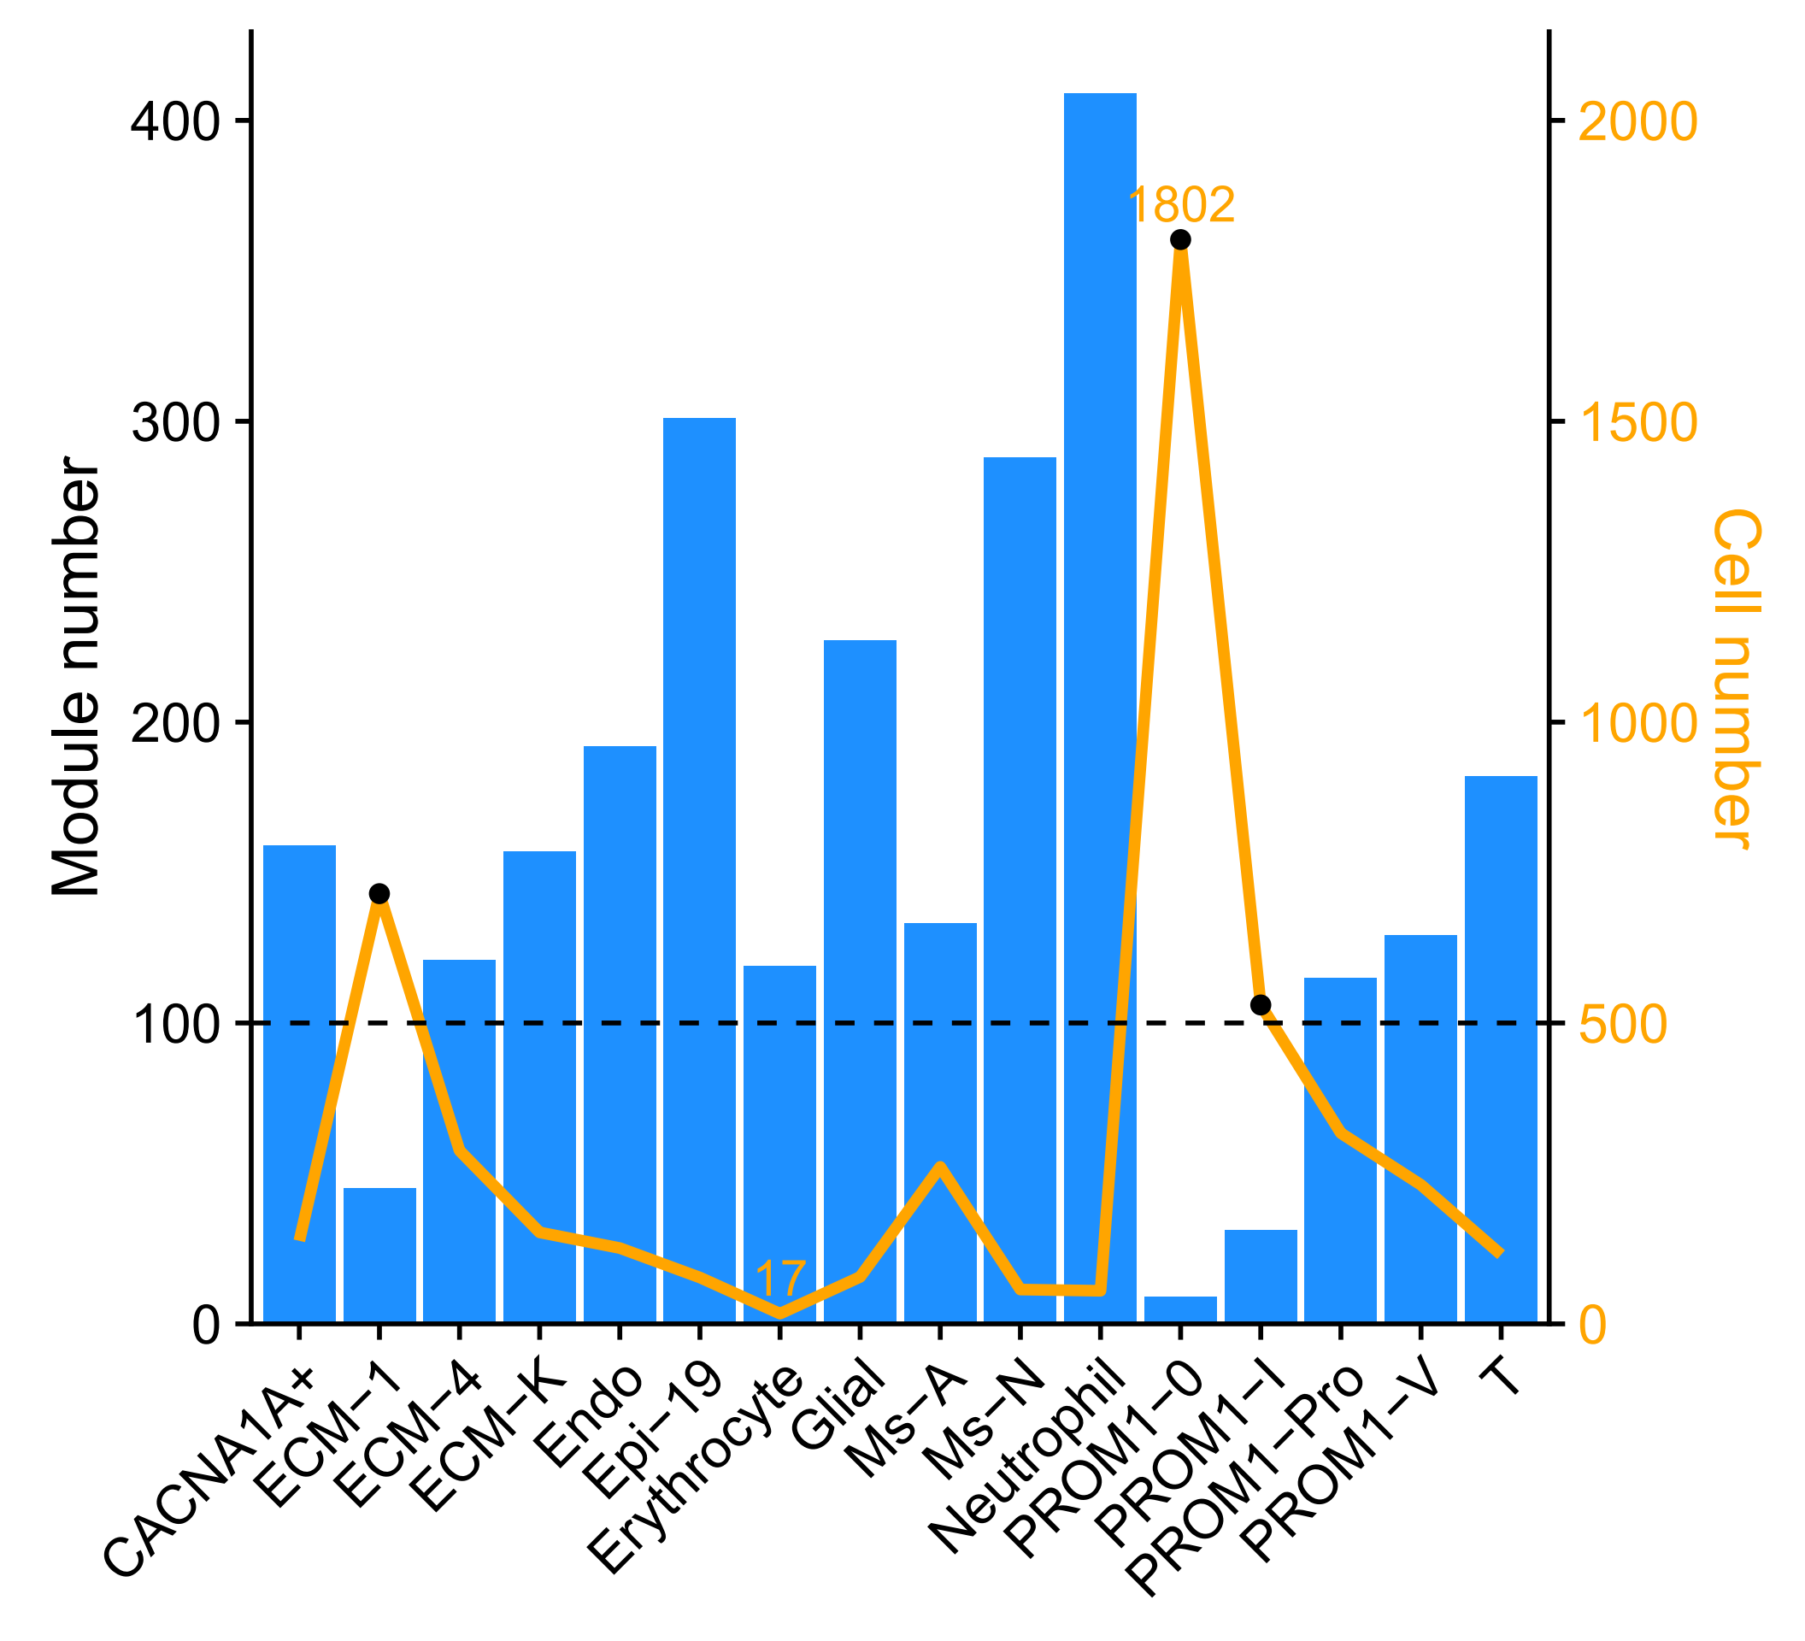
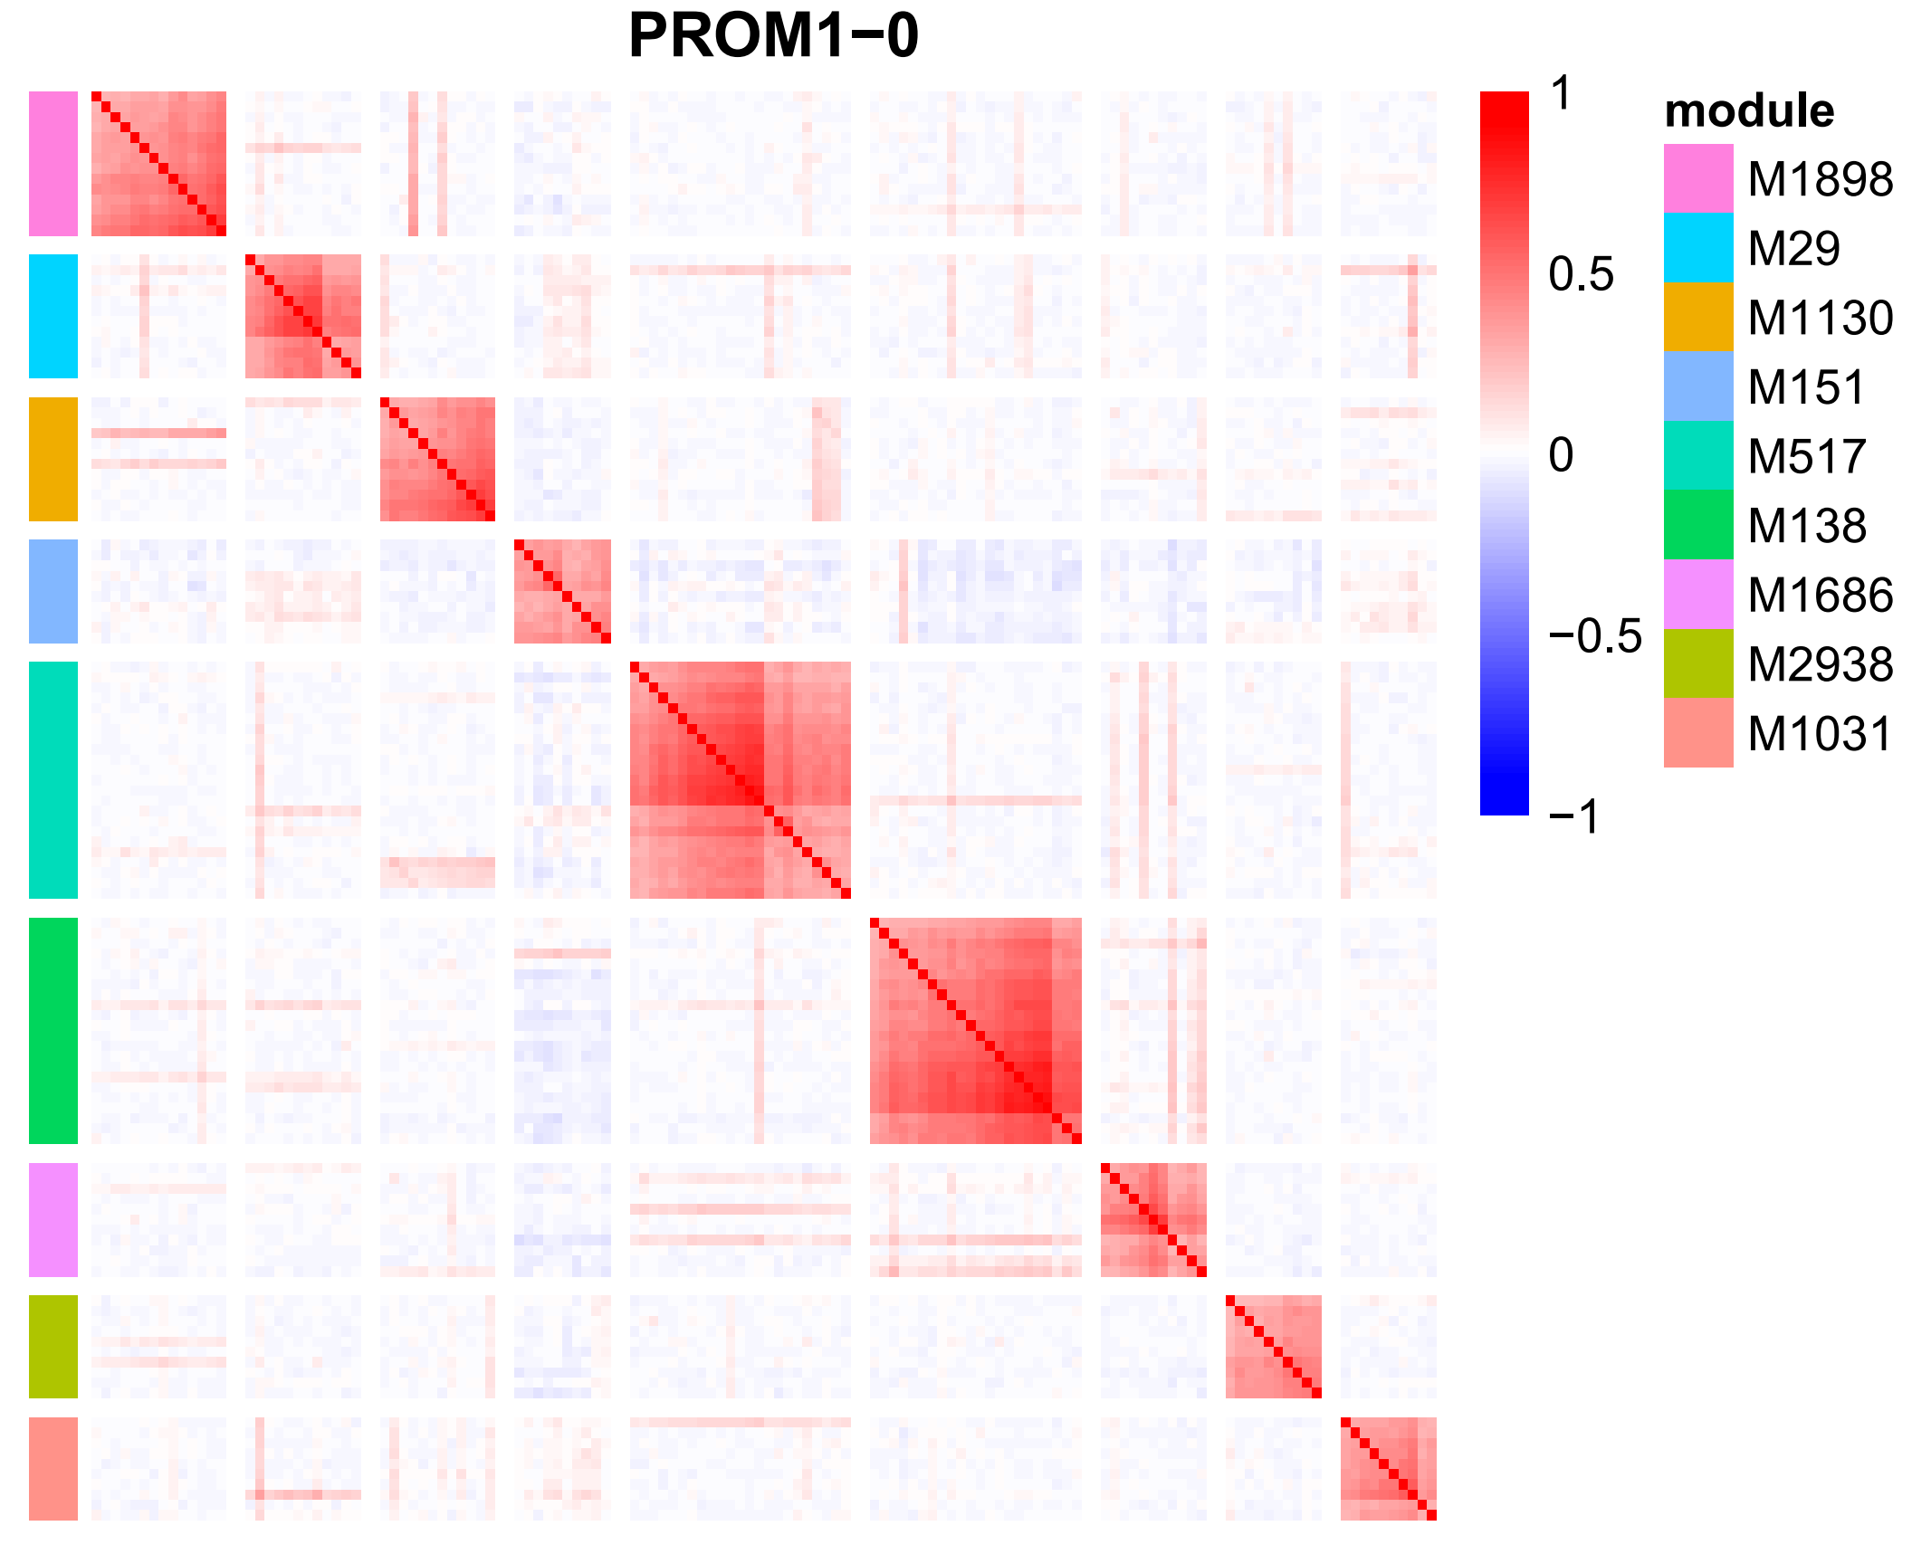
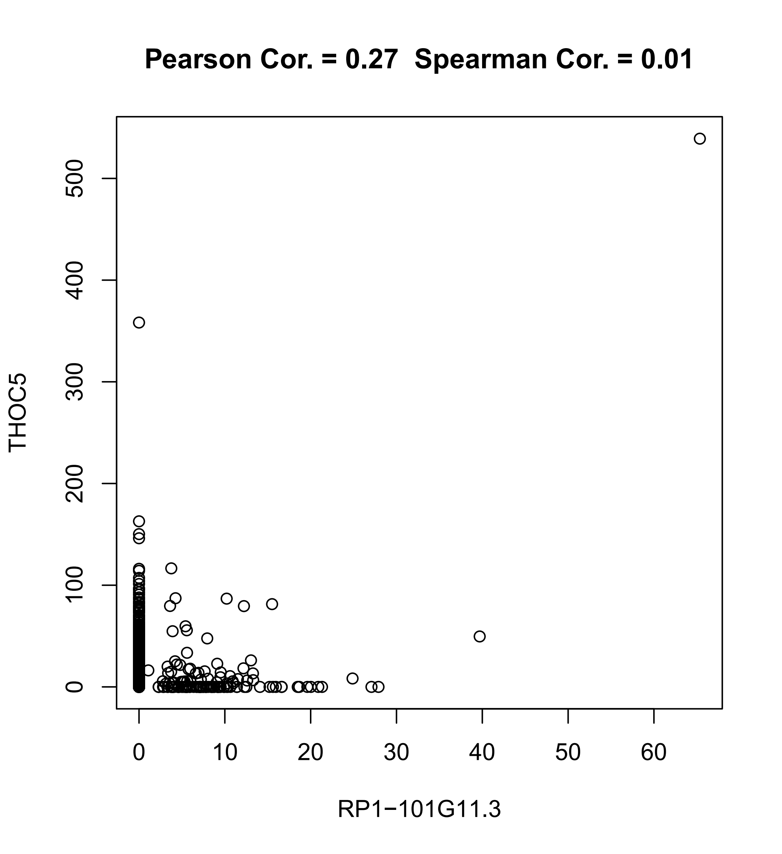
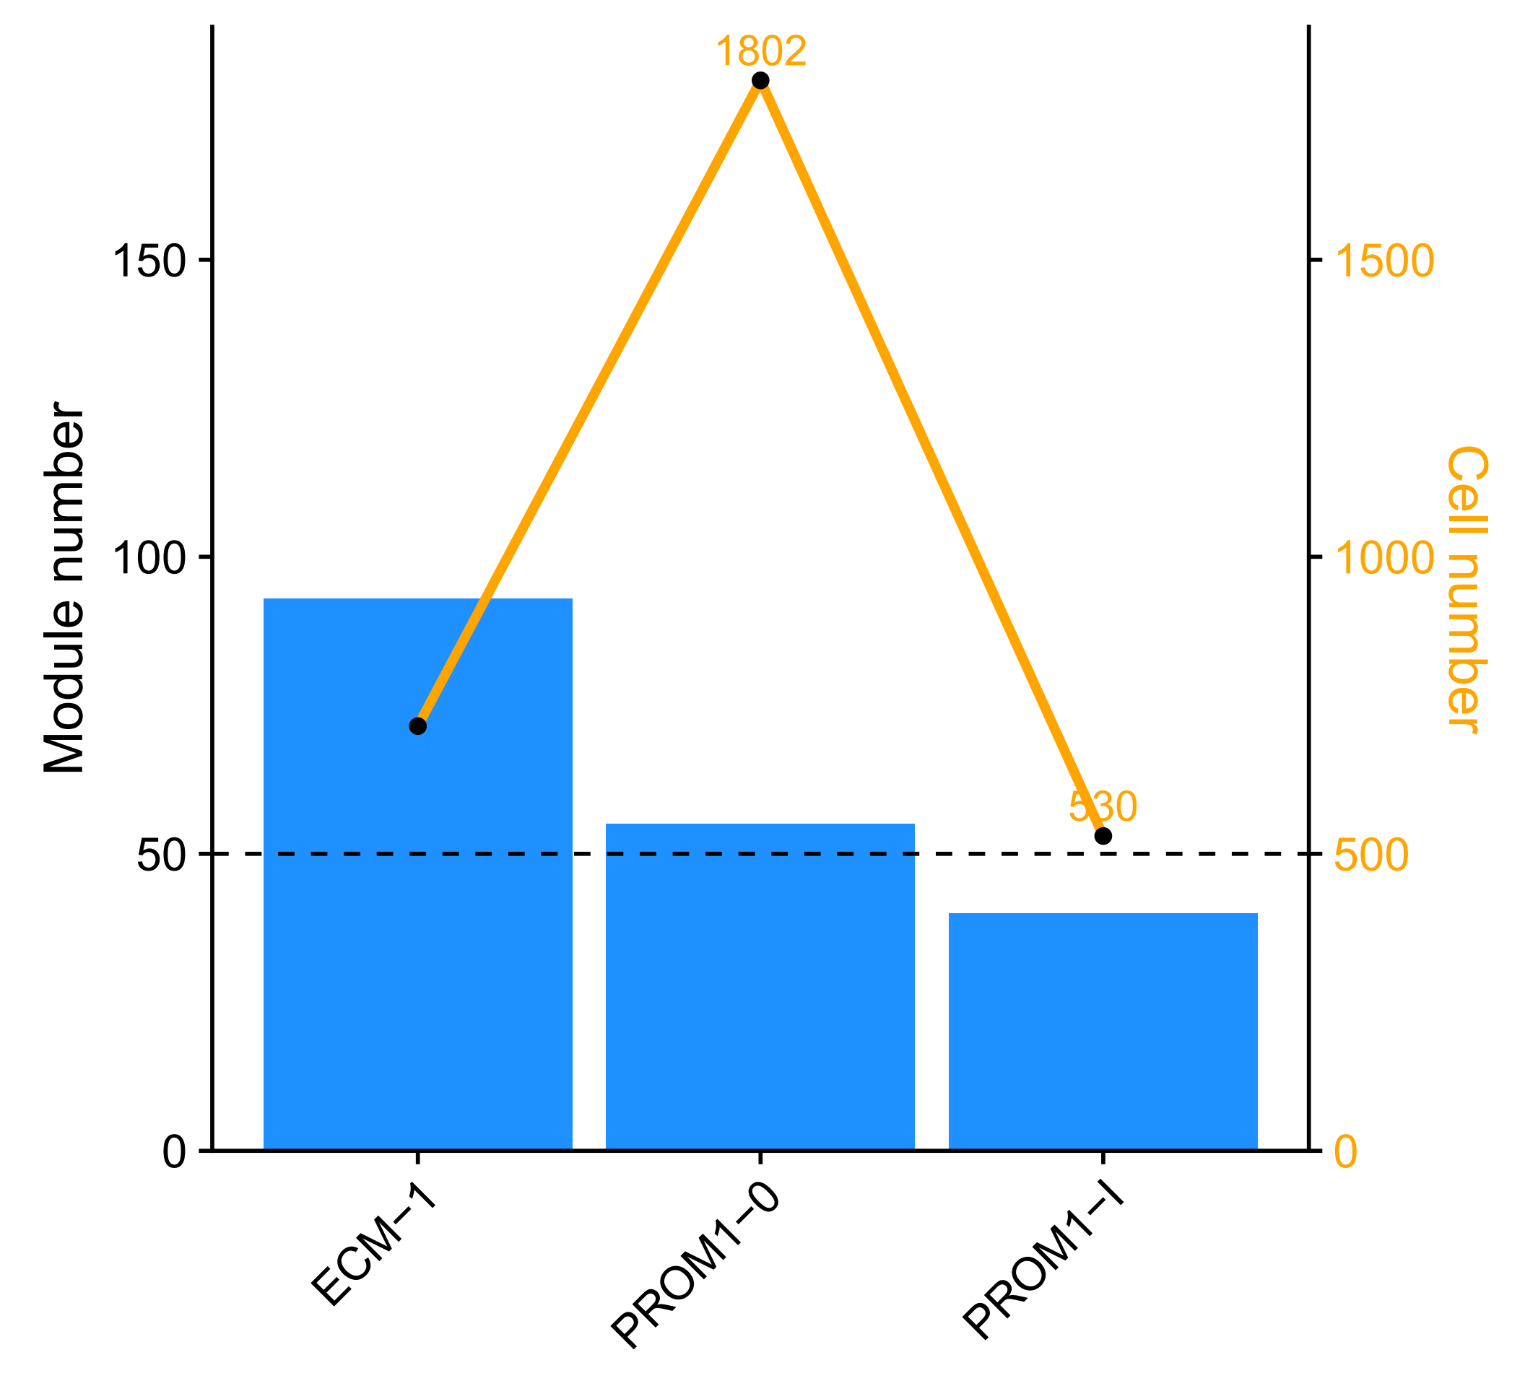
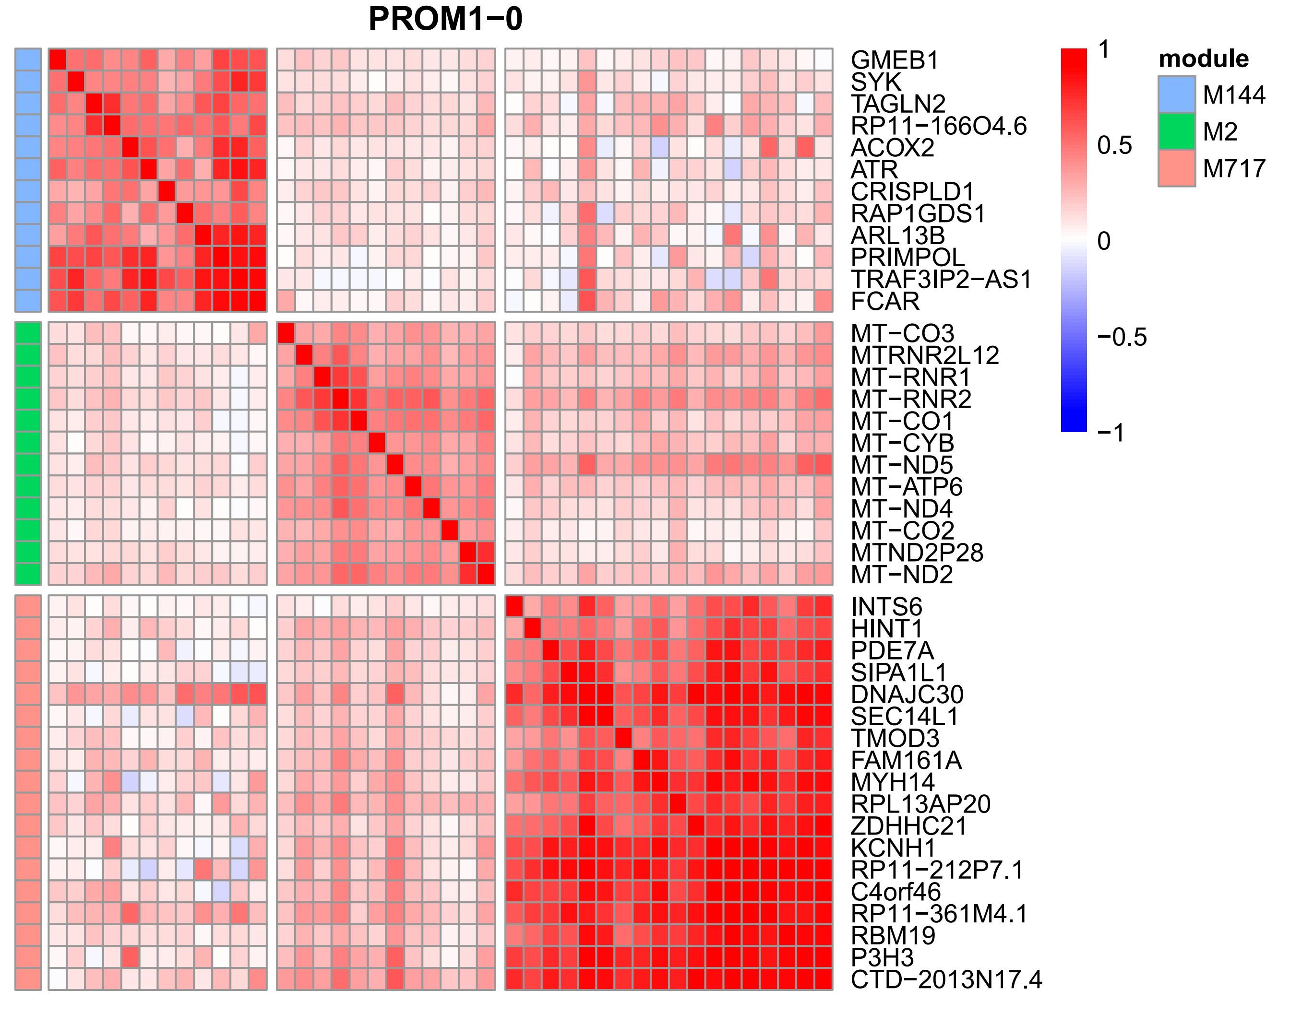
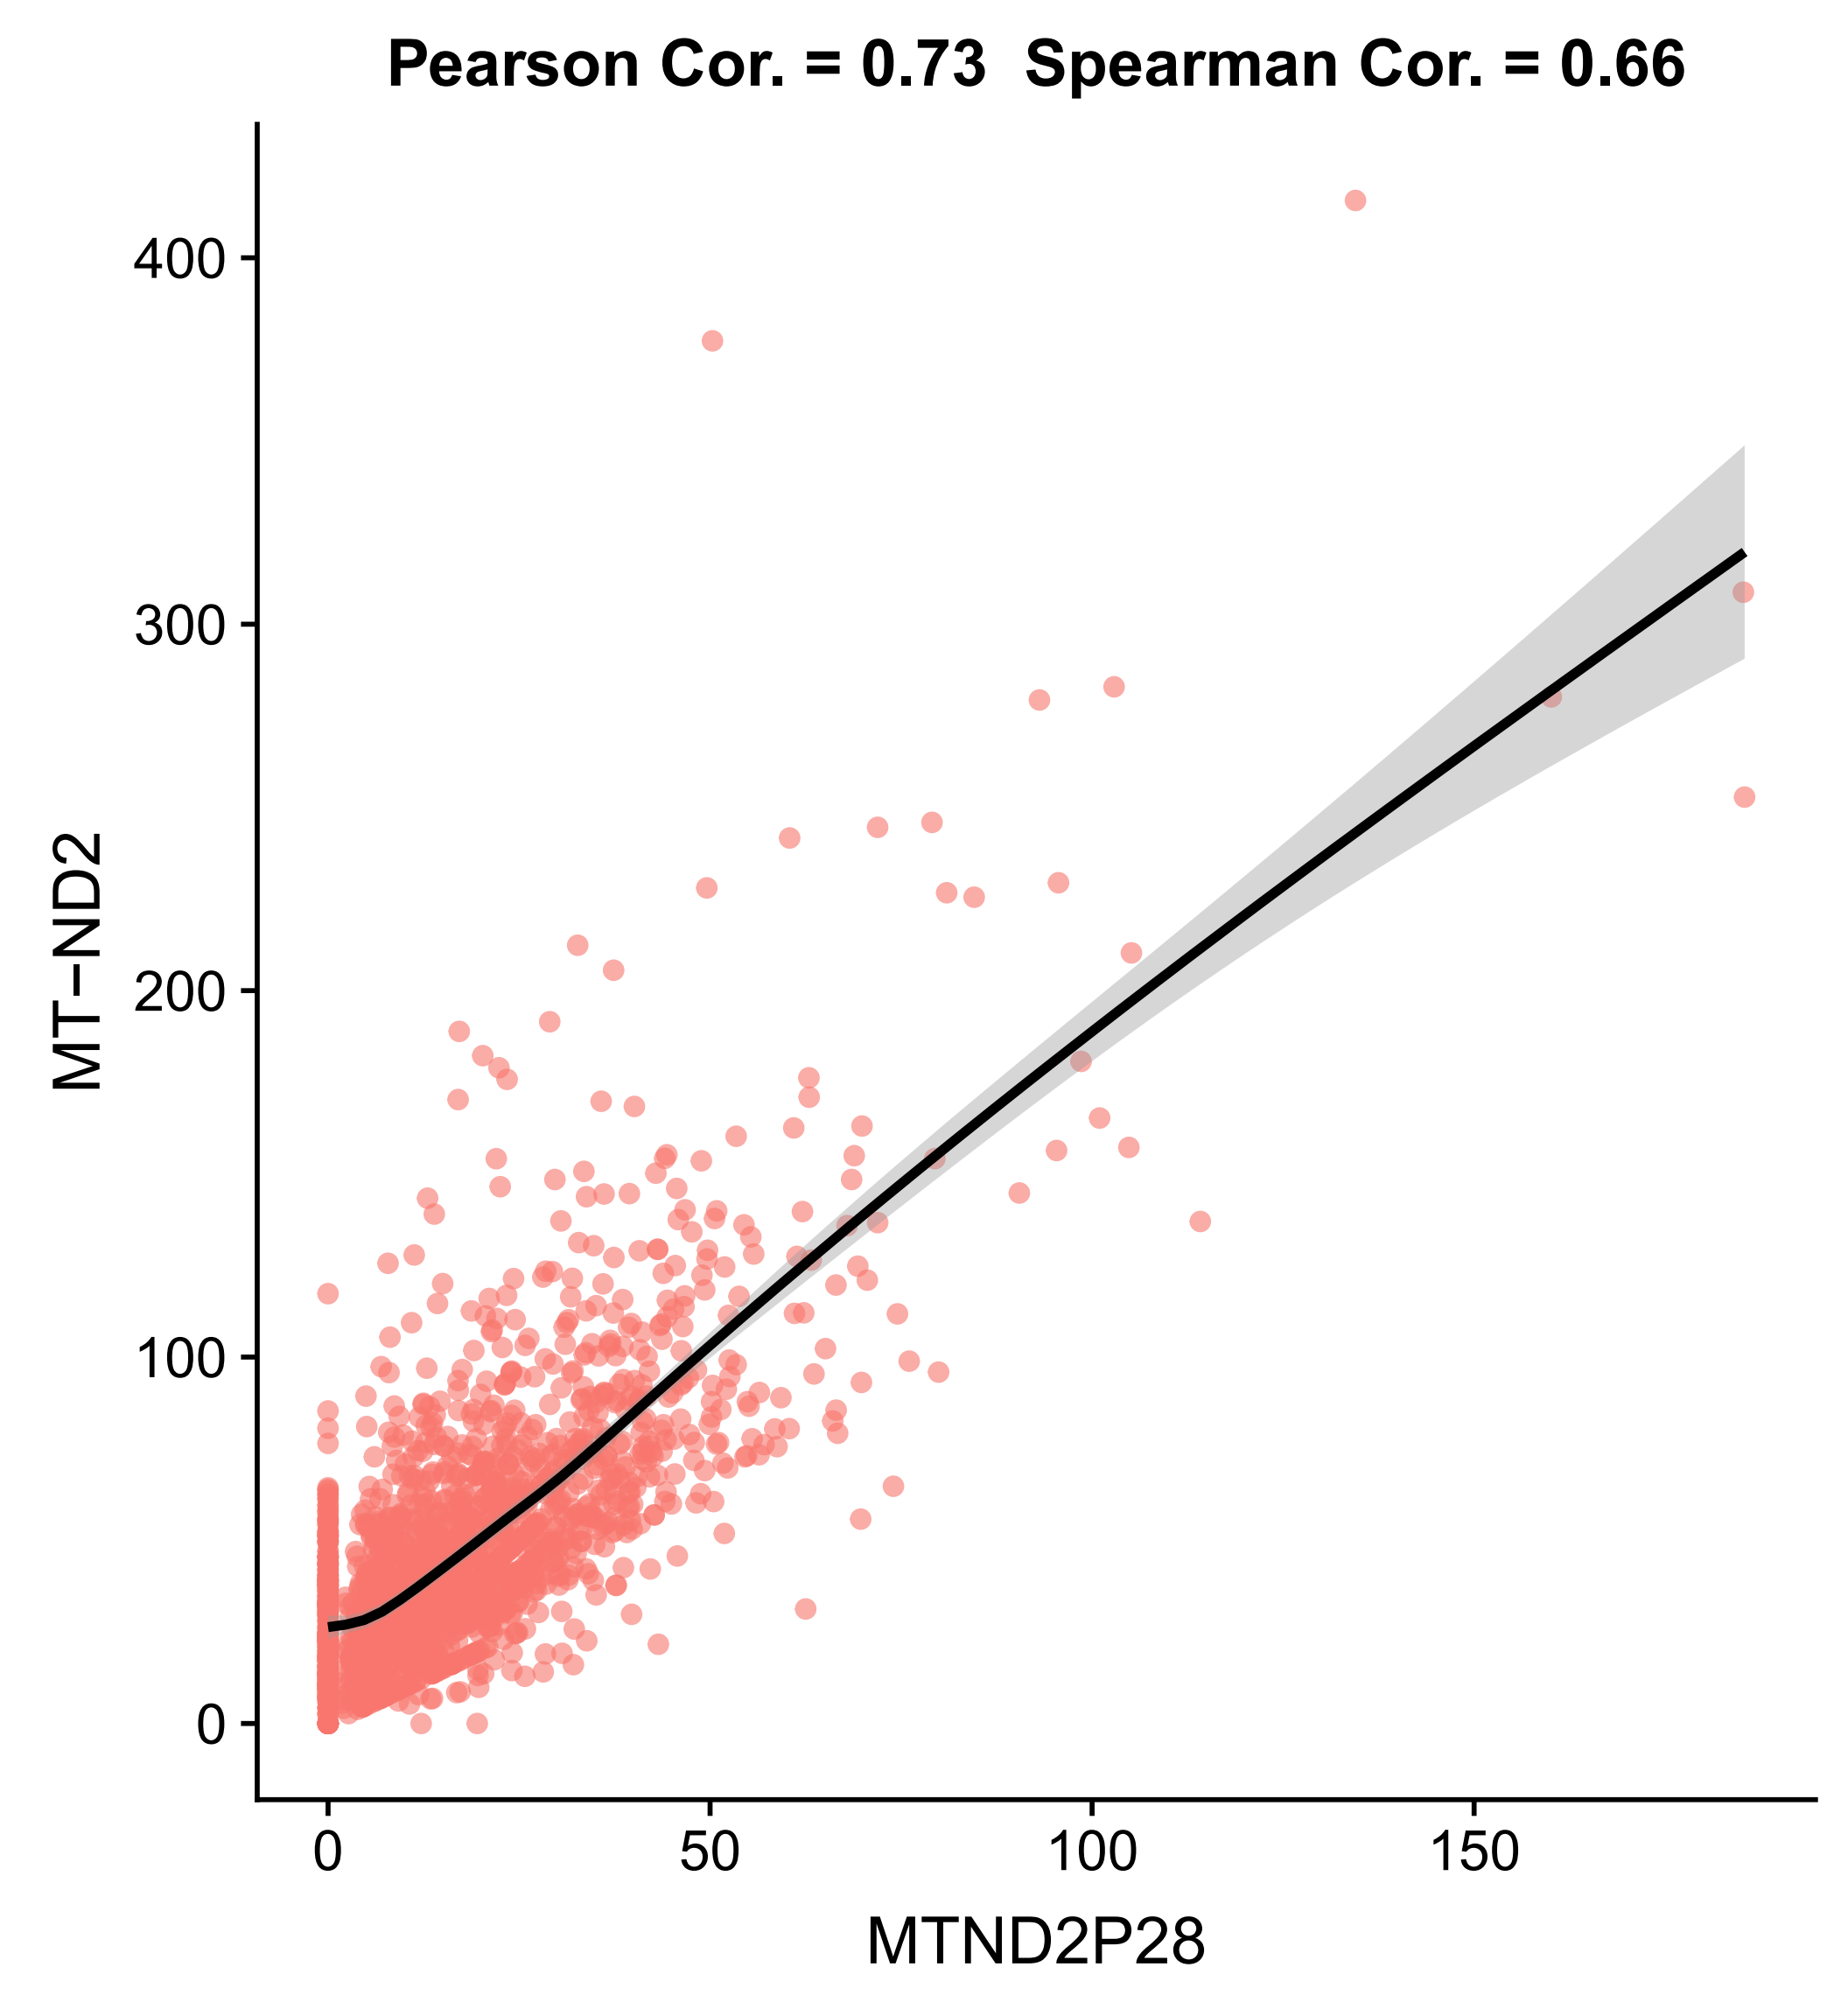
Part4: Co-expression modules within each cell type
A
B
C

Slide 13
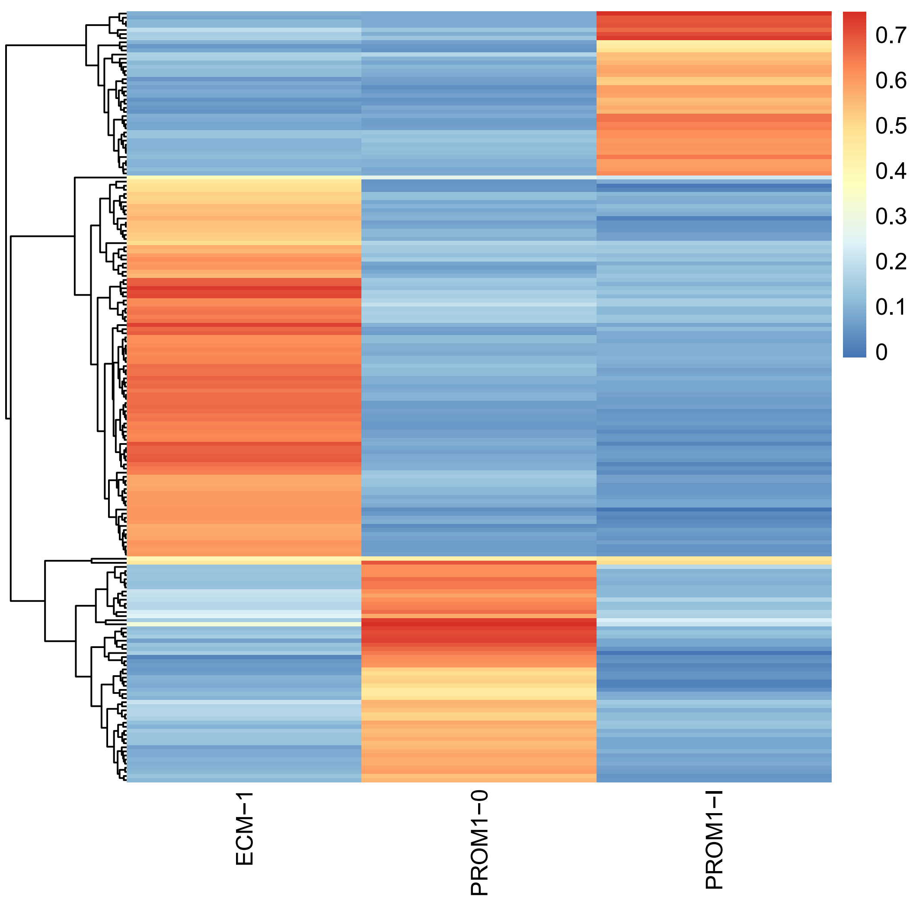
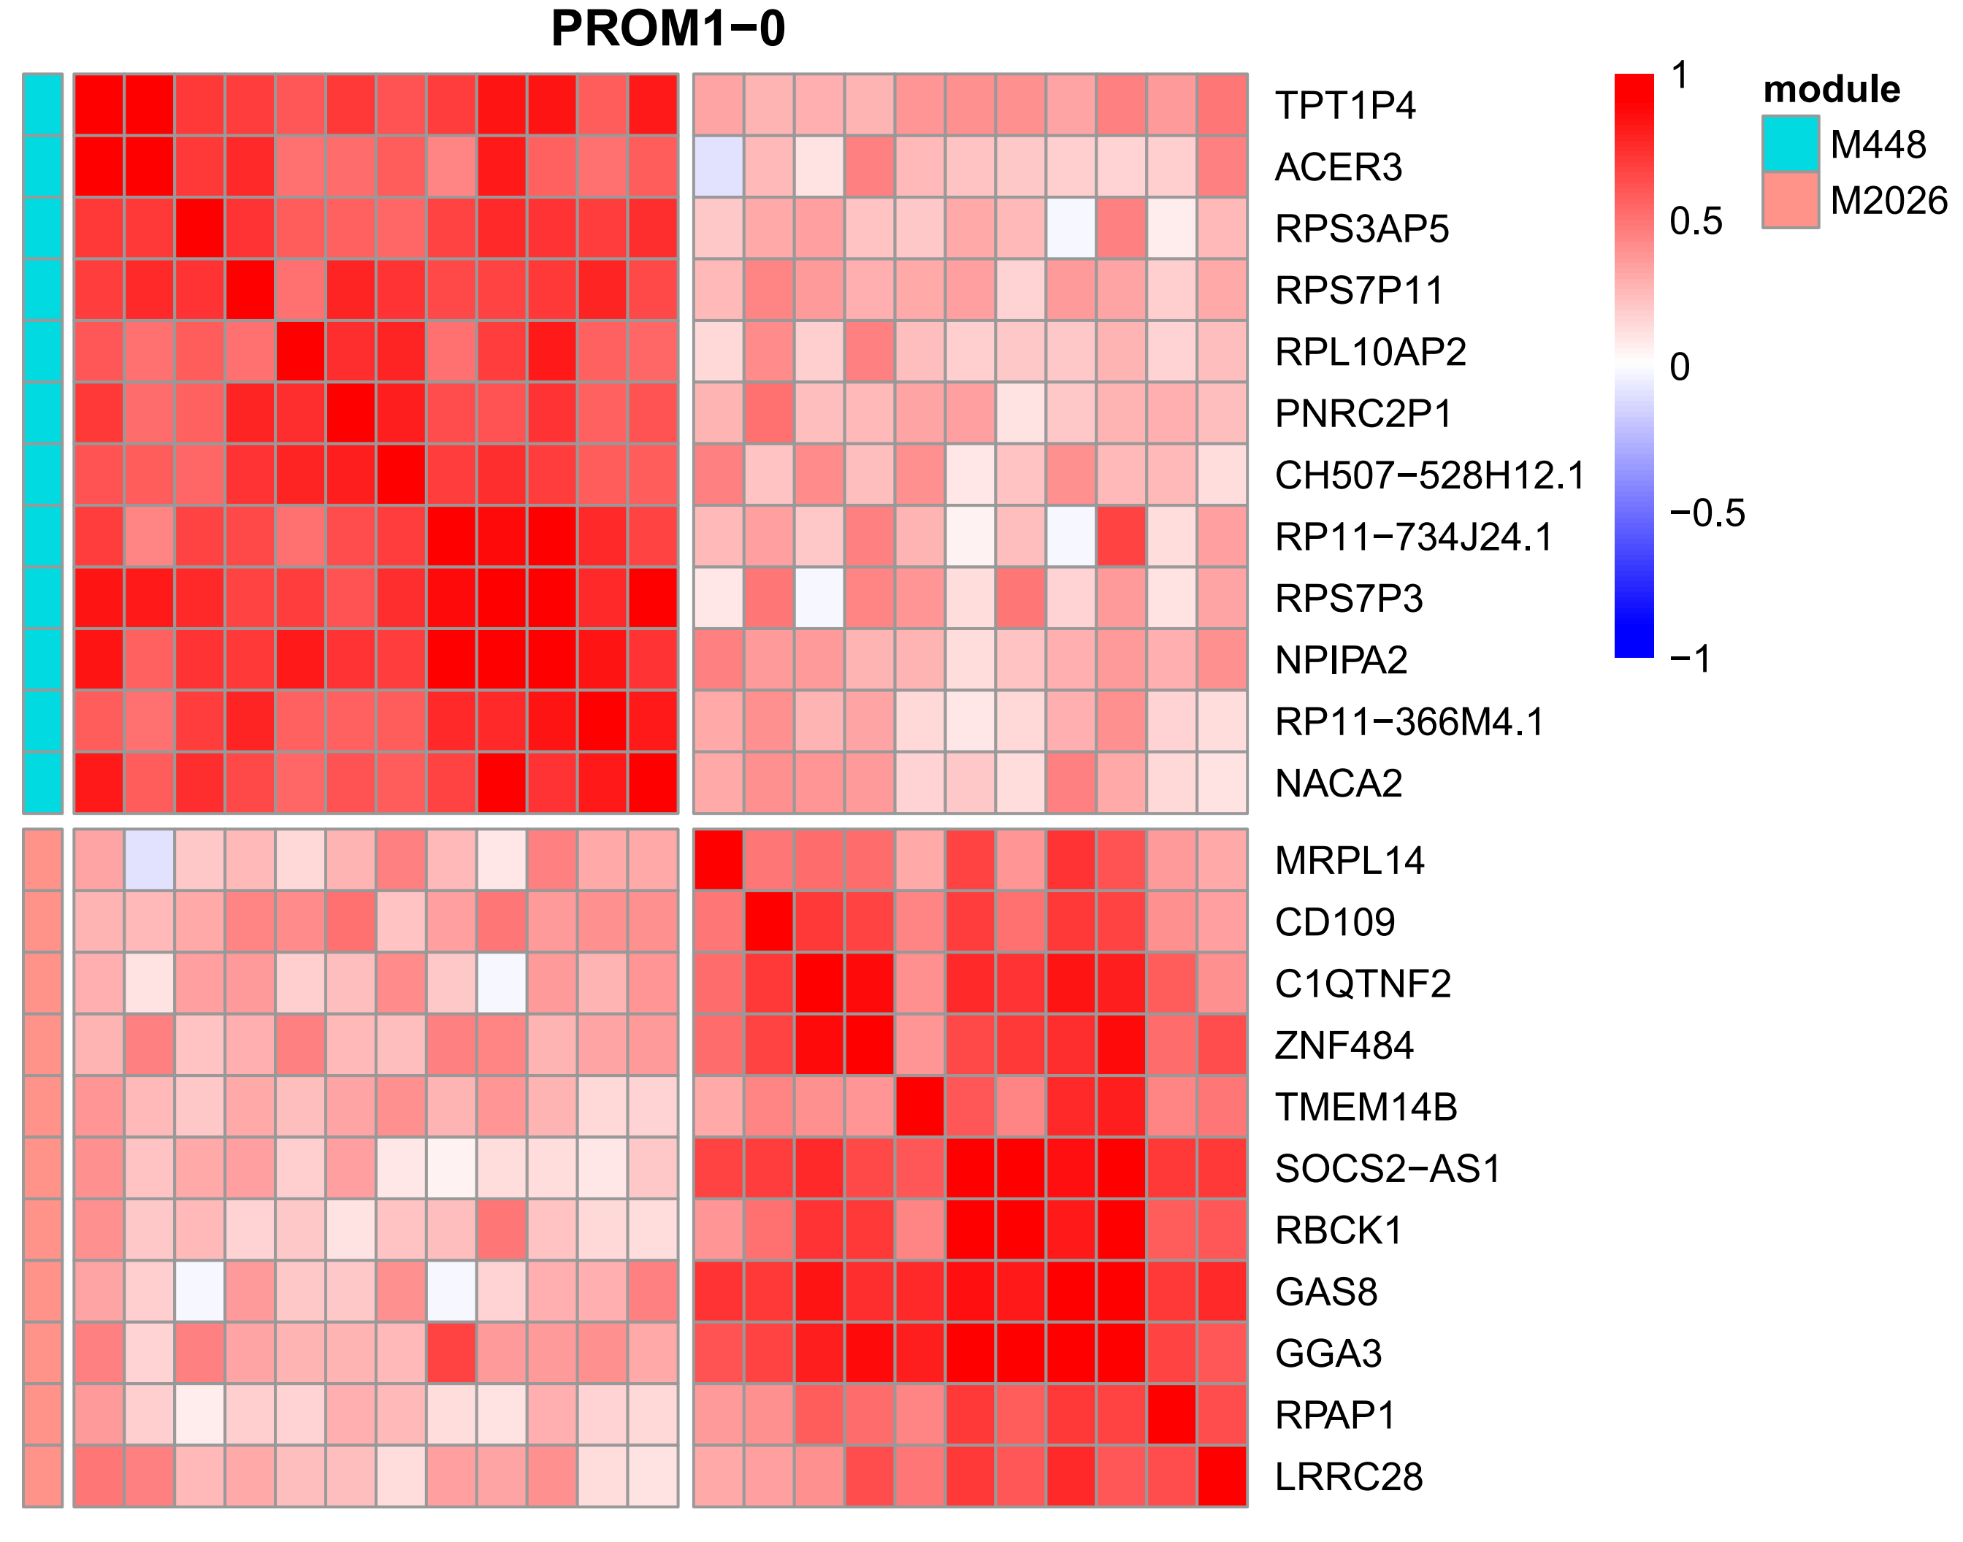
Module map across cell types
Only 2 of 188 modules are ubiquitous in these three cell types.
PROM1-0_M2
PROM1-0_M448

Slide 14
Part5: The spatial - specific expression
Fundus
Body
Antrum

Slide 15
Used tools
SCENIC / R-cistarget

Slide 16
Thanks

